Slide 1
What is C3 Glomerulopathy or C3G for short?

Slide 2
Learning objectives
To understand the anatomy of the kidney and glomerulus
To understand how C3G is diagnosed
To understand the relationship of C3G to post-infectious glomerulonephritis (PIGN) and monoclonal gammopathy of renal significance (MGRS)
To understand that C3G is caused by complement dysregulation
To understand what the complement system does
To understand how we study complement in persons with C3G
To understand that there are many causes of complement dysregulation that can give rises to C3G
To recognize that while there are no disease-specific treatment, the future is very bright and multiple new therapies are being tested in clinical trials

Slide 3
Learning objectives
To understand the anatomy of the kidney and glomerulus
To understand how C3G is diagnosed
To understand the relationship of C3G to post-infectious glomerulonephritis (PIGN) and monoclonal gammopathy of renal significance (MGRS)
To understand that C3G is caused by complement dysregulation
To understand what the complement system does
To understand how we study complement in persons with C3G
To understand that there are many causes of complement dysregulation that can give rises to C3G
To recognize that while there are no disease-specific treatment, the future is very bright and multiple new therapies are being tested in clinical trials

Slide 4
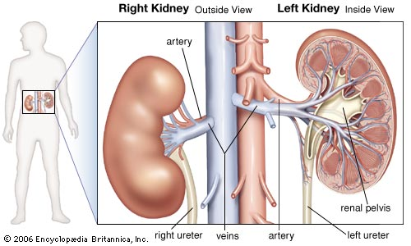
The Kidney

Slide 5
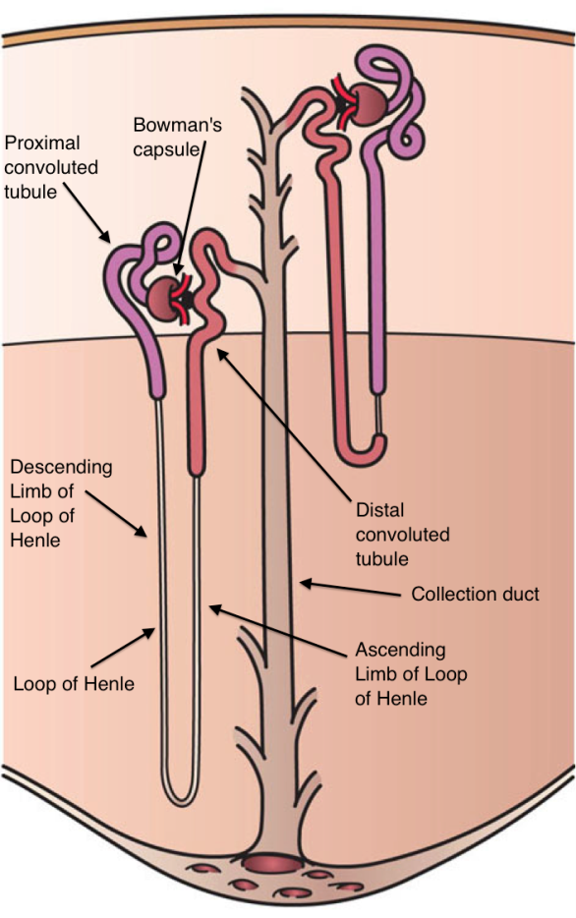
The Nephron
Nephron – the working unit of the kidney

Slide 6
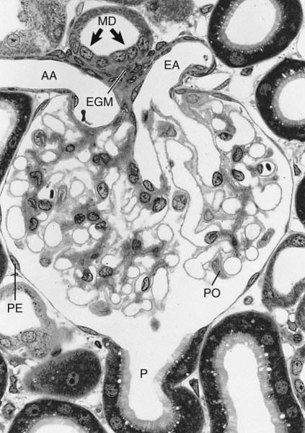
The Nephron
Blood out
Blood in
Nephron – the working unit of the kidney
For C3G, we are interested in the glomerulus

Slide 7
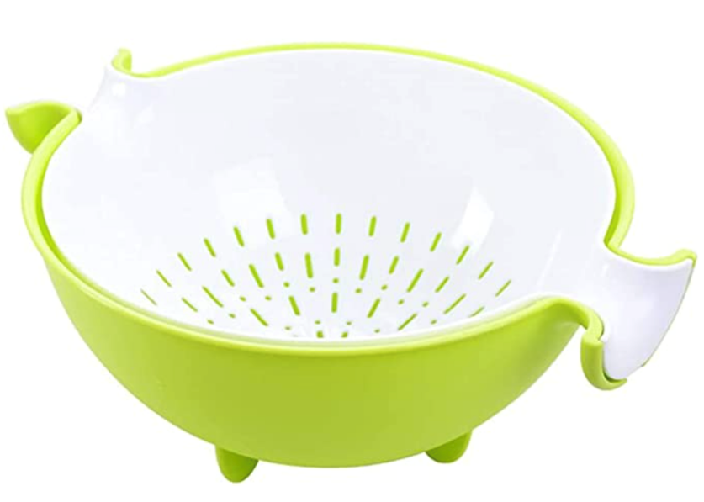
The Nephron
Urine
Blood out
Blood in
Blood in
Capillaries and blood
Blood out
The glomerulus is the filtering unit of the nephron;
it’s like a colander
For C3G, we are interested in the glomerulus

Slide 8
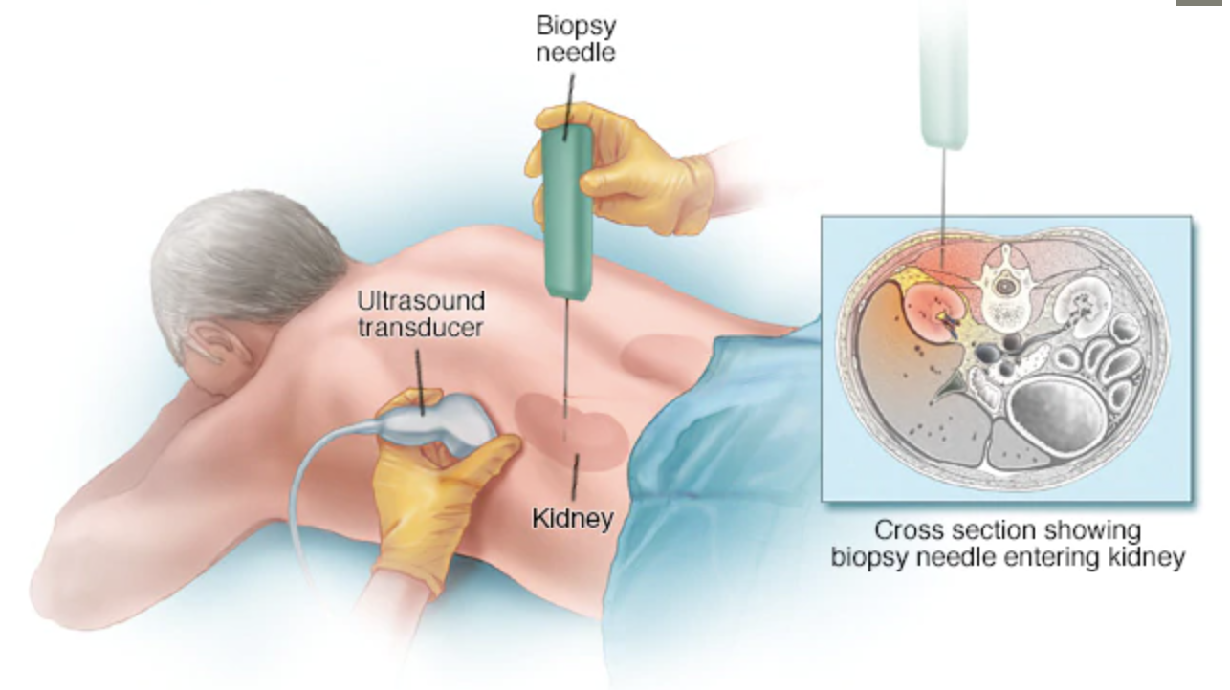

Slide 9
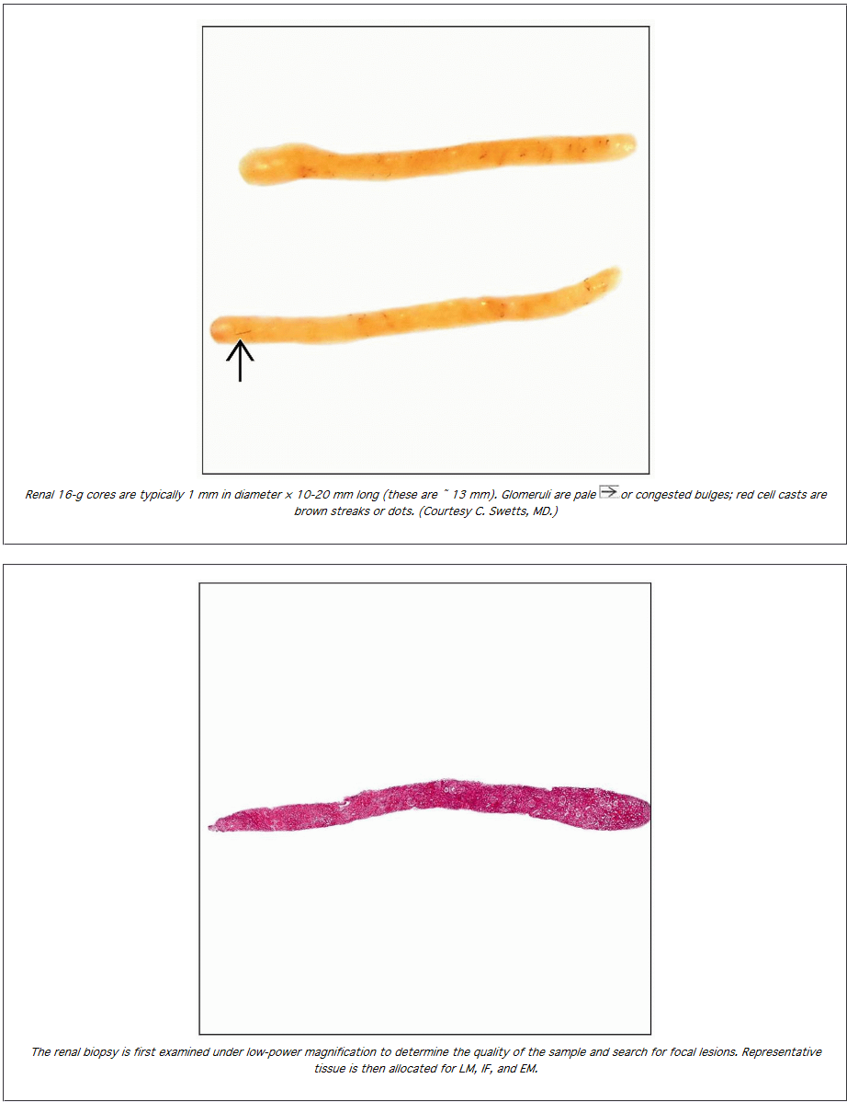
From: https://basicmedicalkey.com/kidney-needle-biopsy-evaluation-for-adequacy/
About 1 mm x 20 mm

Slide 10
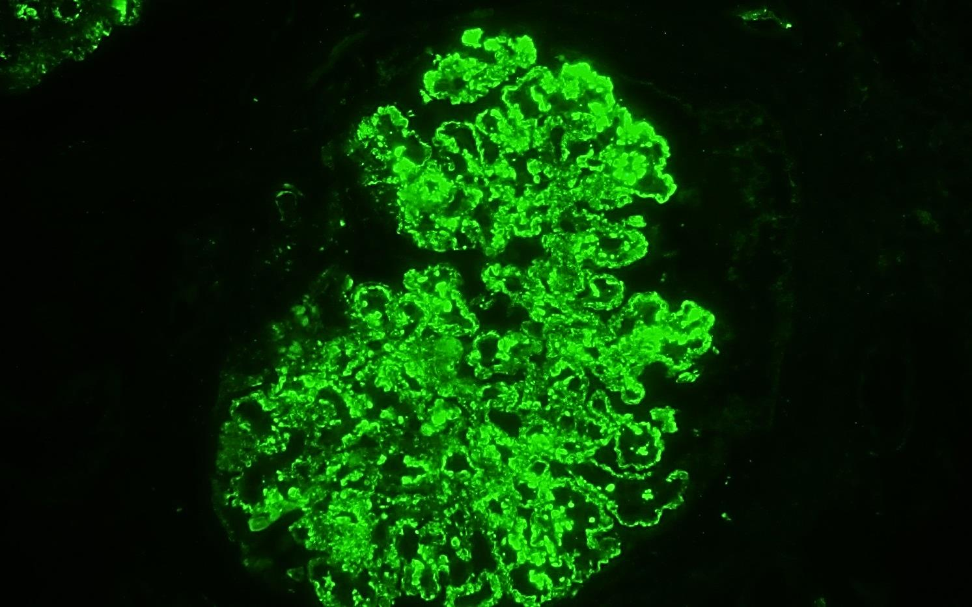
C3G is diagnosed by immunofluorescence staining, which must be positive for C3 by at least two orders of magnitude greater than any other stain.
C3 staining
Immunoglobulins (Ig): IgA, IgG, IgM
Complement (C): C3 and C1q
Light chains: Kappa and lambda

Slide 11
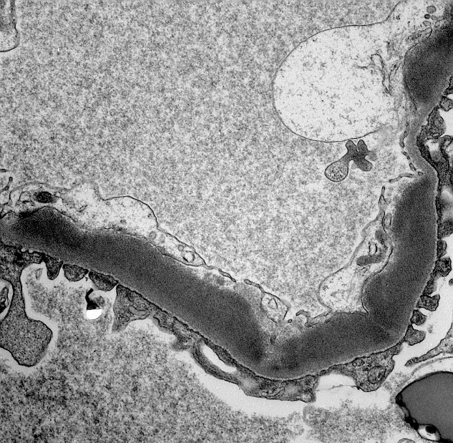
C3G is diagnosed by immunofluorescence staining, which must be positive for C3 by at least two orders of magnitude greater than any other stain.
C3 staining
Immunoglobulins (Ig): IgA, IgG, IgM
Complement (C): C3 and C1q
Light chains: Kappa and lambda
Electron microscopy can then be done to subclassify C3G as Dense Deposit Disease (DDD, shown above) or C3 glomerulo-nephritis (C3GN)

Slide 12
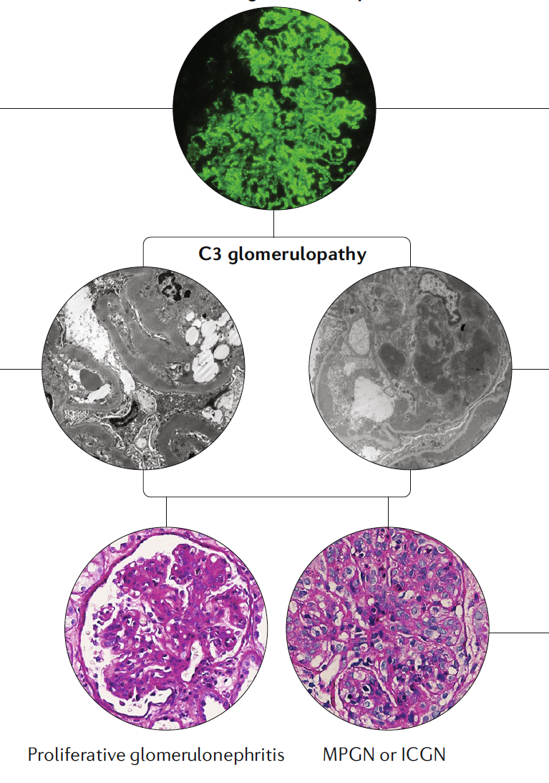
C3 Dominant Glomerulonephritis
Post-infectious Glomerulonephritis
30% of cases are C3 dominant
Complement abnormalities resolve within 8-12 weeks
Persistent abnormalities = reclassification to C3G
Paraprotein-associated glomerulo-nephritis or monoclonal gammo-pathy of renal signif-icance (MGRS)
Adults > 50 y/o
Complement dysregulation driven by paraprotein
Paraprotein-targeted therapy
C3 Glomerulopathy
Smith et al Nature Reviews Nephrol 2019

Slide 13
Learning objectives
To understand the anatomy of the kidney and glomerulus
To understand how C3G is diagnosed
To understand the relationship of C3G to post-infectious glomerulonephritis (PIGN) and monoclonal gammopathy of renal significance (MGRS)
To understand that C3G is caused by complement dysregulation
To understand what the complement system does
To understand how we study complement in persons with C3G
To understand that there are many causes of complement dysregulation that can give rises to C3G
To recognize that while there are no disease-specific treatment, the future is very bright and multiple new therapies are being tested in clinical trials

Slide 14
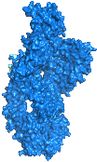
What is C3?
It is the third component (protein) in the complement cascade
It is very abundant in blood
The range of normal values is very broad
To become active, it undergoes a large change in shape

Slide 15
What is C3 Glomerulopathy?
It is an ultra rare disease
It is a disease in which C3, its breakdown products, and other complement proteins build up in the glomerulus
It requires a renal biopsy to make the diagnosis
Its underlying cause is dysregulation of complement
Dysregulation of complement can be caused by different things

Slide 16
What is complement?
It is a defense system in the body
It is very powerful
When it is not properly controlled, a variety of diseases can occur in addition to C3G

Slide 18
So let’s look at the complement system
There are three phases
  Initiation – getting it started
  Amplification – ramping up the process
  Effector – facing the consequences

Slide 19
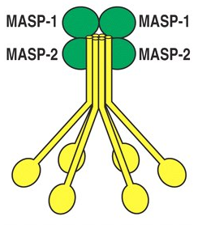
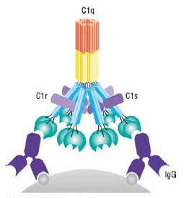
Phase 1
Initiation
Mannose Binding Lectin
Microbial carbohydrates
Classical Pathway
Immune complexes
Alternative Pathway
Activating surfaces
C3
B
C3a
Ba
C4b
2a
C3b
Bb
C3 Convertase
C3 Convertase
Notes:
Let’s briefly review of the complement cascade, a network of about 40 plasma and cell-surface proteins that collaboratively eliminate potentially dangerous cells, debris and particles from the body.
Deployed is a proteolytic cascade, it is a rare example of positive feedback that drives rapid cytocidal and inflammatory responses following episodes of microbial invasion.
The complement system’s activating pathways - the alternative, the lectin, and the classical - converge at the proteolytic activation of plasma protein C3.
Cleavage of C3 entails excision of a small 9 kDa anaphylatoxin, C3a that destabilizes the remaining protein, C3b, which undergoes a conformational rearrangement driven in part by the thioester-containing domain or TED of C3b. The unstable thiol can attach to nearby nucleophiles to create a platform for magnesium-dependent binding of factor B and its subsequent cleavage by factor D to yield the catalytically active C3 convertase.
Uncontrolled deposition of C3b causes opsonization, inflammation and cytolysis.
The entire process is spatially localized because of the high reactivity of the thioester in C3b and temporally localized because of the tendency of C3 convertase to rapidly and irreversibly disassociate.

Slide 20
Phase 1
Initiation
Mannose Binding Lectin
Microbial carbohydrates
Classical Pathway
Immune complexes
Alternative Pathway
Activating surfaces
C3
B
C3a
Ba
C4b
2a
C3b
Bb
C3 Convertase
C3 Convertase
C3b
Bb
Phase 2
Amplification
C3 Convertase
C3
C3b
Notes:
Let’s briefly review of the complement cascade, a network of about 40 plasma and cell-surface proteins that collaboratively eliminate potentially dangerous cells, debris and particles from the body.
Deployed is a proteolytic cascade, it is a rare example of positive feedback that drives rapid cytocidal and inflammatory responses following episodes of microbial invasion.
The complement system’s activating pathways - the alternative, the lectin, and the classical - converge at the proteolytic activation of plasma protein C3.
Cleavage of C3 entails excision of a small 9 kDa anaphylatoxin, C3a that destabilizes the remaining protein, C3b, which undergoes a conformational rearrangement driven in part by the thioester-containing domain or TED of C3b. The unstable thiol can attach to nearby nucleophiles to create a platform for magnesium-dependent binding of factor B and its subsequent cleavage by factor D to yield the catalytically active C3 convertase.
Uncontrolled deposition of C3b causes opsonization, inflammation and cytolysis.
The entire process is spatially localized because of the high reactivity of the thioester in C3b and temporally localized because of the tendency of C3 convertase to rapidly and irreversibly disassociate.

Slide 21
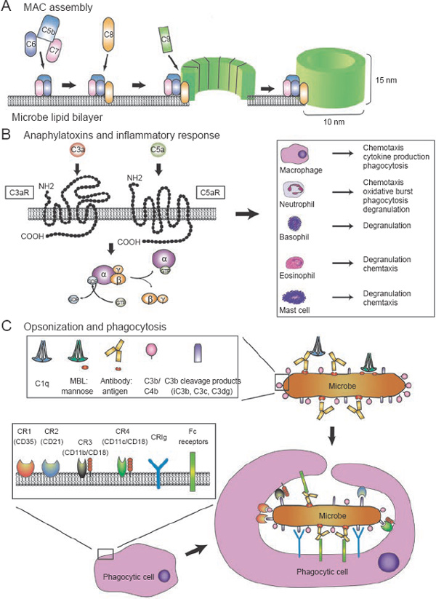
Phase 1
Initiation
Mannose Binding Lectin
Microbial carbohydrates
Classical Pathway
Immune complexes
Alternative Pathway
Activating surfaces
C3
B
C3a
Ba
C4b
2a
C3b
Bb
C3 Convertase
C3 Convertase
C3b
Bb
Phase 2
Amplification
C3 Convertase
C3
C3b
Inflammation
C3b
Bb
C3b
Opsonization
Terminal
Pathway
C3a
C5a
Phase 3
Effector
C5 Convertase
Lysis
Notes:
Let’s briefly review of the complement cascade, a network of about 40 plasma and cell-surface proteins that collaboratively eliminate potentially dangerous cells, debris and particles from the body.
Deployed is a proteolytic cascade, it is a rare example of positive feedback that drives rapid cytocidal and inflammatory responses following episodes of microbial invasion.
The complement system’s activating pathways - the alternative, the lectin, and the classical - converge at the proteolytic activation of plasma protein C3.
Cleavage of C3 entails excision of a small 9 kDa anaphylatoxin, C3a that destabilizes the remaining protein, C3b, which undergoes a conformational rearrangement driven in part by the thioester-containing domain or TED of C3b. The unstable thiol can attach to nearby nucleophiles to create a platform for magnesium-dependent binding of factor B and its subsequent cleavage by factor D to yield the catalytically active C3 convertase.
Uncontrolled deposition of C3b causes opsonization, inflammation and cytolysis.
The entire process is spatially localized because of the high reactivity of the thioester in C3b and temporally localized because of the tendency of C3 convertase to rapidly and irreversibly disassociate.

Slide 22
Phase 1
Initiation
Mannose Binding Lectin
Microbial carbohydrates
Classical Pathway
Immune complexes
Alternative Pathway
Activating surfaces
C3
B
C3a
Ba
C4b
2a
C3b
Bb
C3 Convertase
Exquisite control of the complement system is needed
C3 Convertase
C3b
Bb
Phase 2
Amplification
C3 Convertase
C3
C3b
Inflammation
C3b
Bb
C3b
Opsonization
Terminal
Pathway
C3a
C5a
Phase 3
Effector
C5 Convertase
Lysis
Notes:
Let’s briefly review of the complement cascade, a network of about 40 plasma and cell-surface proteins that collaboratively eliminate potentially dangerous cells, debris and particles from the body.
Deployed is a proteolytic cascade, it is a rare example of positive feedback that drives rapid cytocidal and inflammatory responses following episodes of microbial invasion.
The complement system’s activating pathways - the alternative, the lectin, and the classical - converge at the proteolytic activation of plasma protein C3.
Cleavage of C3 entails excision of a small 9 kDa anaphylatoxin, C3a that destabilizes the remaining protein, C3b, which undergoes a conformational rearrangement driven in part by the thioester-containing domain or TED of C3b. The unstable thiol can attach to nearby nucleophiles to create a platform for magnesium-dependent binding of factor B and its subsequent cleavage by factor D to yield the catalytically active C3 convertase.
Uncontrolled deposition of C3b causes opsonization, inflammation and cytolysis.
The entire process is spatially localized because of the high reactivity of the thioester in C3b and temporally localized because of the tendency of C3 convertase to rapidly and irreversibly disassociate.

Slide 23
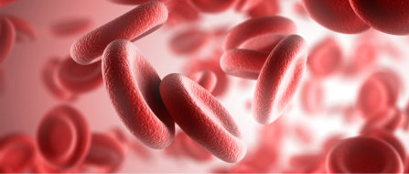
What’s happening in the kidney in C3G?
C3b
Bb
C3 Convertase
C3
C3b

Slide 24
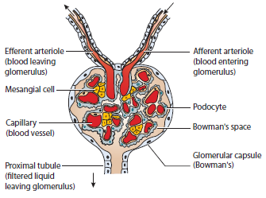
C3b
Bb
C3 Convertase
C3
C3b

Slide 25
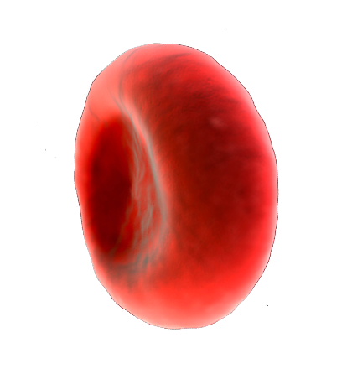
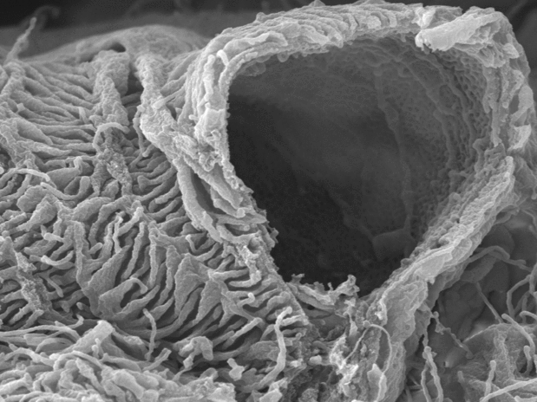
Urine
C3b
Bb
C3 Convertase
C3
C3b
Haraldsson B et al. Physiol Rev 2008;88:451-487
Notes:
The extent to which the GBM is serum exposed and must be protected from complement-mediated damage is staggering – the fenestrated area of glomerular endothelial cells constitutes 20–50% of the entire endothelial surface. Coating the luminal surface of both the endothelial cells and the exposed GBM is an overlying glycocalyceal matrix, a 200nm-thick web of sialic acid-rich proteoglycans and glycosaminoglycan side chains the dysfunction of which has been linked to proteinuria.

Slide 26
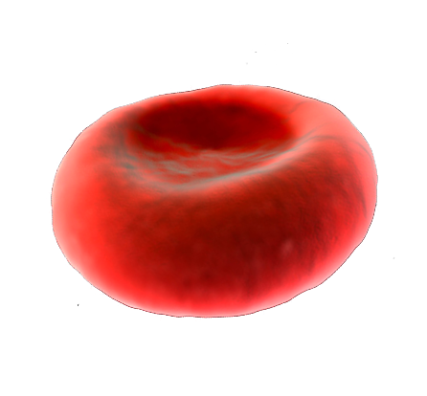
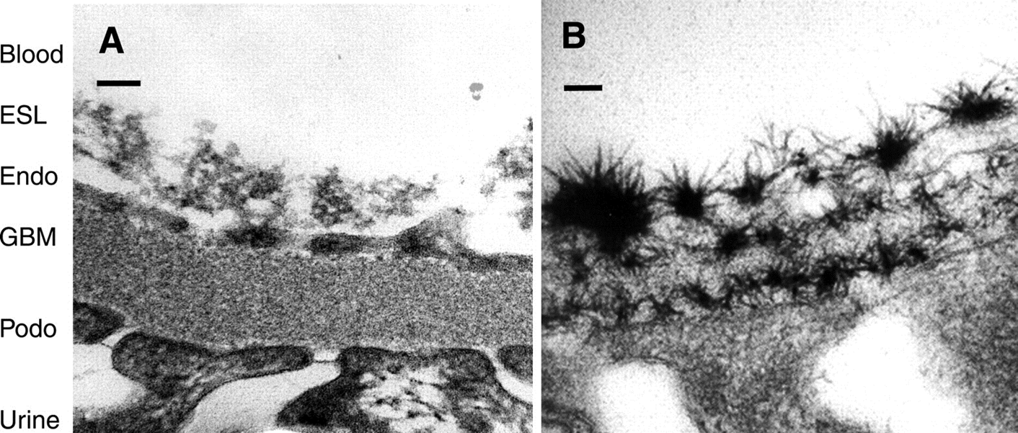
C3b
Bb
sC5b-9
C3 Convertase
C3b
C3
C3b
C3b
C3b
Bb
Bb
Bb
C3b
C3b
Bb
C3b
Bb
C3b
C3b
The dense deposits seen on electron microscopy
Urine
Urine
Haraldsson B et al. Physiol Rev 2008;88:451-487

Slide 27
What causes complement dysregulation in C3G?
Autoantibodies called nephritic factors – 40-60%
Genetic mutations – 20%
Unknown – 20-40%

Slide 28
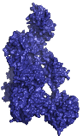


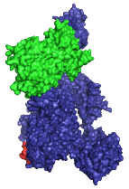
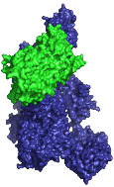
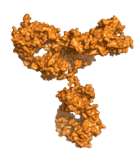
Nephritic factors
Stabilize C3 convertase so it will not decay as it should
Prevent regulatory proteins from working properly
C3b
C3
Factor H
sC5b-9
X
C5 Convertase
C3 Nef
Glycomatrix

Slide 29
Genetic mutations
A mutational hotspot in C3 accounts for about 2% of cases
C3b

Slide 30
How do we stop this mess?
Current therapy is supportive
There are a large number of clinical trials to test new anticomplement drugs
Iowa is the leading center worldwide for these trials

Slide 31
How do we stop this mess?

Slide 32
Take home points
C3G is an ultra rare disease
It CANNOT be diagnosed without a kidney biopsy
It is caused by dysregulation of the alternative pathway of complement
Dysregulation can be caused by genetic and acquired factors
Each patient should have a thorough genetic and complement functional evaluation
Numerous anti-complement drugs are in clinical trials making the future bright for persons with C3G

Slide 33
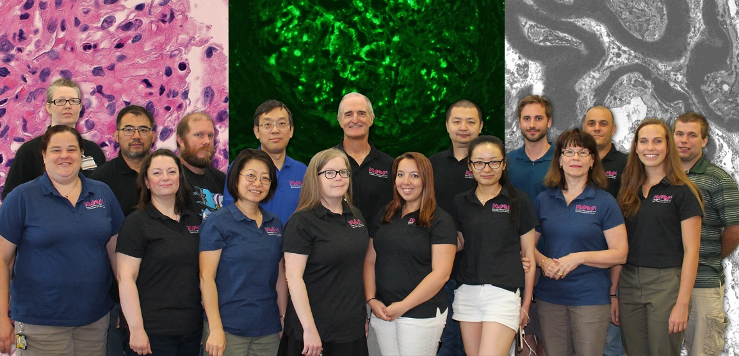
We thank the NIH for its support and the patients who entrust us with their care.

