Slide 1
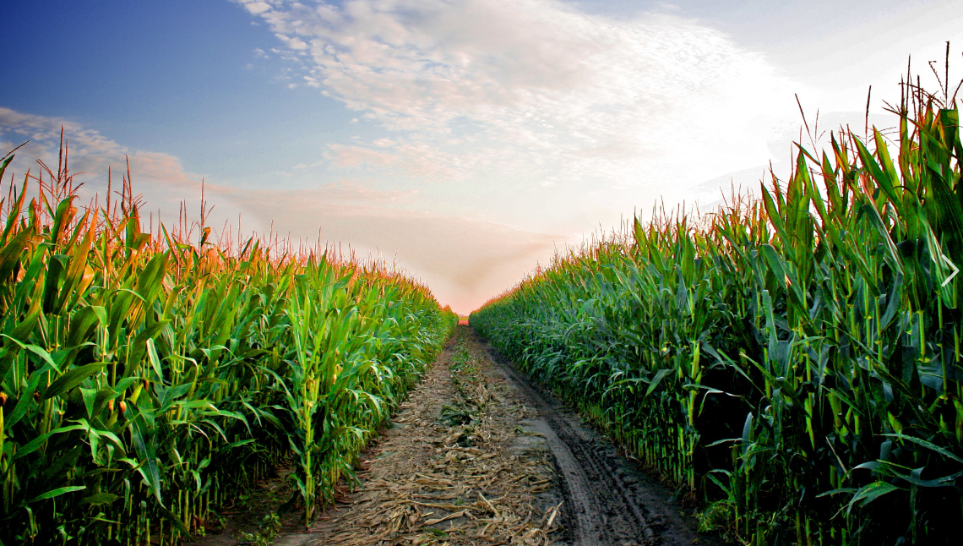
Welcome to Iowa!
Notes:
Hello!
I am Monica Hall –
-Coordinator of our C3G Natural History Study
-Nurse Coordinator for our Univ of Iowa Rare Renal Clinics
covered By Dr. Carla Nester
I want to personally welcome you – and to
thank each and every one of you for participating in our C3G Family meeting
– whether it be in Person – or Virtually!
I’m so happy to see you all here!

Slide 2

Natural History Studies gather information on how a disease affects a person over a lifetime.
Notes:
When a disease is Rare, such as C3G,
Collected data is especially valuable
And can lead to New Understandings
Breakthroughs
And Treatments
Natural History Studies inform researchers (such as our MORL team)
About the subtleties of the disease
Things that are NOT in textbooks and NOT in the literature …. Yet,…
Our goal is to make Novel discoveries
in efforts to bring therapeutic HOPE to our C3G patients.
Soon I will share with you some of the subtilities
We are finding through our C3G Natural Hx S Database
But before that –
I’d like to share with you how VAST our database patient population is…….

Slide 3
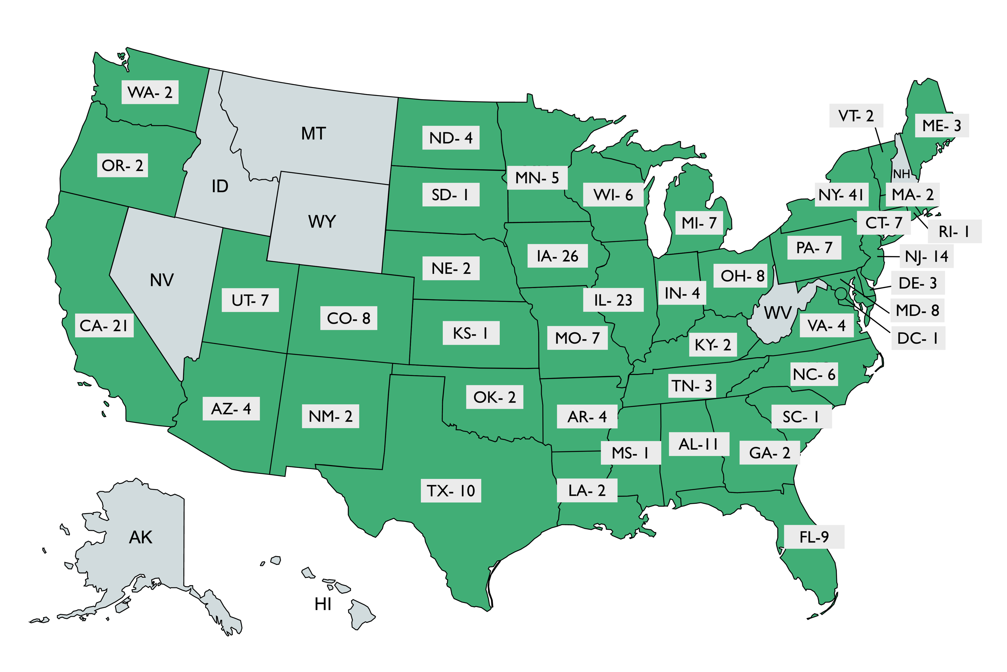
We’re in 43 states…
Notes:
Our University of Iowa Natural History Study is currently the Largest in the World
In our database, called RedCap, we have enrolled 327 patients in 43 states……………….

Slide 4
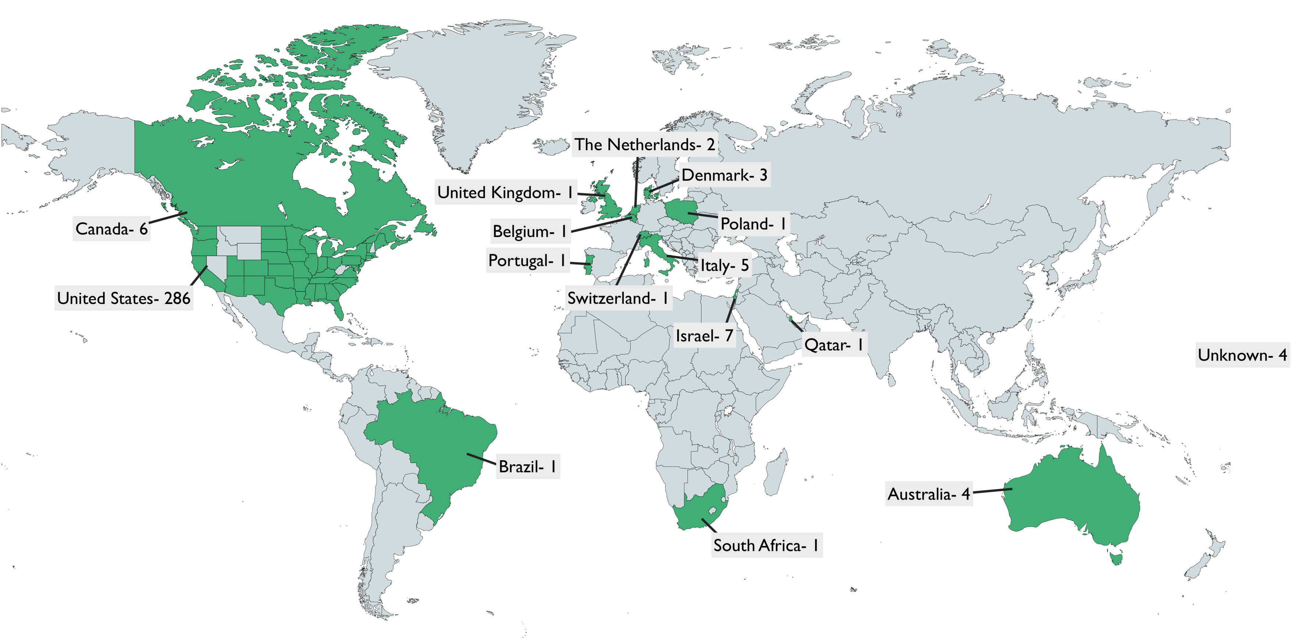
And 15 countries!
Notes:
And 15 different countries.
All 327 patients have had kidney biopsies
Over 300 of these patients have had genetic renal panels
and with these 327 patients –
we have reviewed over 1000 C3G Functional/biomarker panels
meaning each patient has had at least 1 biomarker panel
– and some have had up to 16 panel results

Slide 5
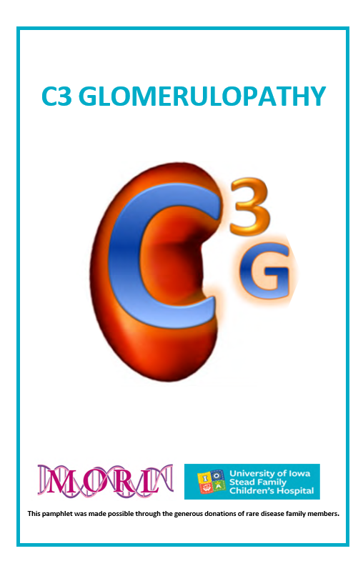
Education
This pamphlet was made possible through the generous donations of rare disease family members.
Notes:
For participants that are here today
– you will find our C3G Education pamphlet in your conference folder:
This pamphlet was MADE POSSIBLE through the generous donations from rare disease family members.
Our C3G NHxS team made this pamphlet as an educational tool to be used during clinic visits
– to aide Dr. Nester as she educates our patients and families on C3G.
It has been so well received that we now share this pamphlet with nephrologists who contact us
–requesting guidance with difficult C3G cases in their local areas. we use it as a “Virtual Teaching Module”
C3G is often undiagnosed or diagnosed late
–With shared education – we hope to offer a more Proactive approach to C3G care vs Reactive.
This morning Richard and Carla covered many of the aspects in our Educational Pamphlet, so I will just briefly highlights:
Page 1- What is C3G? -
Page 2- Pathology –
Page ¾- interpreting biomarkers/genetics
Page 5- complement cascade –
Page 6- Shows a few Outcomes/Treatment Strategies and a place for patients or families to take Notes

Slide 6
C3 tends to stay within ± 25 mg/dL of baseline value
Minimal change in eGFR over 1 year span
No association of baseline C3 level and change in UPCR/GFR
Individuals with low C3 at baseline rarely achieve stable GFR or UPC reduction
Modest association between ACE inhibitor use (Lisinopril/Enalapril) and decline in proteinuria
Notes:
Knowledge gained from a NHxS can lead to Improvement In Treatment.
In Rare Disease, doctors and patients can find themselves unprepared to manage the disease,
and unsure of what to expect as the disease progresses.
This Poster that was presented at the American Society of Nephrology Kidney Week 2020
To understand what this the typical landscape of the C3 Level on our patient population
– we evaluated the trends in our Database:
we found – with CURRENT standards of C3G treatment (NOT ones in drug trials or after transplant)
1 –GFR changes slowly overall – in our cohort, there was minimal change in GFR over a 1 year time span
our patients follow the already known tread – 50% of patients with C3G go to ESRD in 10 yrs
when treated with current available treatment.
3 –C3 tends does not fluxuate a great deal over time
(each patient has their own “normal or nadir” C3 level)
No current tx strategies alter the C3 level
(this is why we NEED to fnd a TX that stops the upstream dysregulation of the AP)
3 – Individuals with a low C3 at baseline – RARELY achieve STABLE UPCR/GFR
– (people w/ low C3’s typically have a more difficult course)

Slide 7
Most pregnancies are uneventful and have good outcomes for both mom and baby
Higher risk of developing preeclampsia (1/3 of C3G pregnancies)
Higher risk of delivering before 37 weeks gestation (1/5 of C3G pregnancies)
No excess risk of miscarriage, low birth weight, ectopic pregnancy, or needing a c-section compared to a typical pregnancy
Notes:
Natural History studies document the current standard of care for patients
and CAN uncover ways Standard CARE can be Improved.
At times, women with C3G can be discouraged from becoming pregnant.
Although we do recognize each patient is unique in their disease,
from our data collected – we have changed our discussion
with women and educate them on our latest findings.
This poster was presented at American Society of Nephrology Kidney Week 20
In our cohort of women with C3G who become pregnant – we found
1 – Most pregnancies and deliveries were uneventful and had good outcomes for both mom and baby
2 – Expectant moms with C3G DO, however, have a higher risk of developing preeclampsia (1 out of 3)
preeclampsia – defined as having elevated blood pressure;
with some moms also retaining water and spilling protein in their urine
3 – 1 out of 5 moms with C3G will deliver a bit early – before 37 weeks gestation
4 – In compared to women without C3G – in our cohort – we DID NOT find our patient population to
have a higher risk of miscarriage, low birth weight, ectopic pregnancy or needing a C section
We educate our C3G moms when interested in becoming pregnant
– and we will surveil them closely and adjust meds accordingly if needed
(monthly) for, elevated BP, urine protein, serum creatinine
– every 3 months or more often if we note a rise, increased BP and Urine protein

Slide 8
Looked at a group of 40 C3G patients who received a kidney transplant - 11 had disease recurrence.
Demographic characteristics (sex, ethnicity, age, DDD vs. C3GN) do not increase risk of recurrence.
Everyone who recurred had a C3 <90, but so did ½ of the non-recurrence group. Having a low C3 does not necessarily mean you will recur.
Developed scoring system for forecasting outcome, showing that excess complement activity across multiple biomarker assays was the best predictor of recurrence.
Looking at all the biomarkers and genetic variants, 5 biomarkers that were significantly different between recurrence and non-recurrence groups.
On evaluating each patient post kidney transplant, 1 point was awarded for each abnormal biomarker or genetic variant.
A total score of 3 or greater indicated high-risk for C3G recurrence (100% of the recurrence group had 3+ points).
Notes:
One of our more valuable achievements this past year was the development of a recurrence risk tool that can
assist transplant nephrology teams in determining who is at greatest risk of recurrent C3G Post transplant.
This scoring system is unprecedented in C3G and will
function to facilitate a proactive surveillance plan for patients post transplant.
This was a poster was presented -European Meeting on Complement in Human Disease in Switzerland 8/2022
We found some biomarkers (C3, C3c, C3 and C5 nephs and sMAC)
play a roll in defining RISK RECURRENCE.
This research is of great value – and plays a significant role in moving our understanding forward.
We can BEST PREPARE for post transplant Success
we can work to ensure there is a treatment strategy in place
- so in the event clinical and histologic recurrence arise
the patient has access to a drug trial showing successful outcomes
or we can assist local MD’s request MAP – compassionate use
To that point - I will also mention that
Our C3G NHXS is a conduit to our Clinical Trials
80% of enrollees into drug trials come from our NHxS
The only way we will find a Treatment for C3G – is to have clinical trial participation.
The Univ of Iowa is the lead recruitment site WORLD-WIDE for the Factor B Inhibitor Trial
and we are the only site currently enrolling adolescents in the C3 Inhibitor Trial.

Slide 9
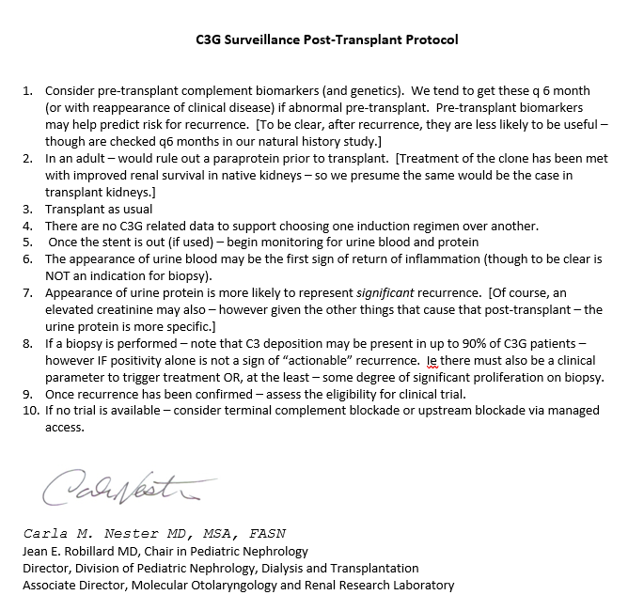
Notes:
W receive many calls and e-mails from local transplant providers requesting guidance on
Post transplant C3G recurrence and how to surveil patients,
we have also developed a protocol for POST TRANSPLANT surveillance protocol:
C3G recurrence is defined as one who has both Clinical AND Histologic Recurrence in their transplanted kidney.
If a stent is placed post transplant – once it is out – you begin to monitor for urine blood and protein
The appearance of urine blood may be the 1st sign of return of inflammation [but not an indication to biopsy]
The appearance of urine protein is more likely to represent SIGNIFICANT recurrence (or an elevated creatinine)
– but urine protein is more specific since there are so many factors that could attribute to a rise in creatinine.
When the transplanted kidney is biopsied - C3 deposition MAY be present in up to 90% of C3G patients.
Positivity of C3 alone on Immunofluorescence is NOT a sign of “actionable” recurrence
There must also be a clinical parameter to trigger Treatment some degree of significant proliferation on bx.
Once recurrence has been confirmed – assess the eligibility for clinical trial.
If no trial is available – consider terminal complement blockade or upstream blockade via managed access.

Slide 10
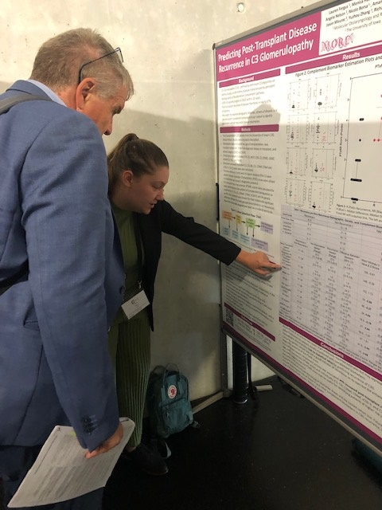
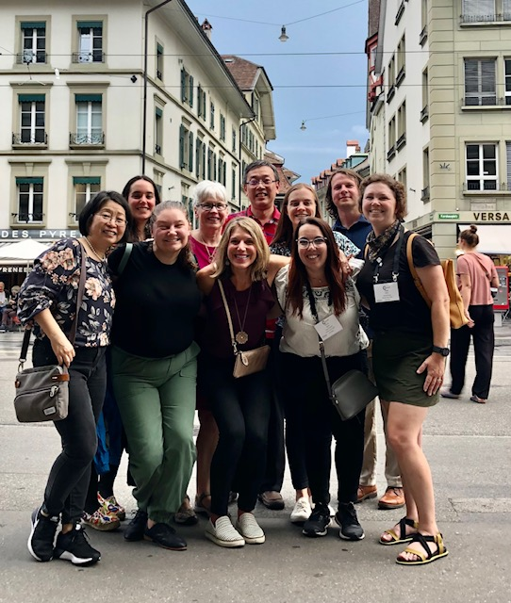
Notes:
I wanted to share a few pictures from our August trip to the European Meeting
C3G Lead Student – Lauren Fergus – presenting her poster on Transplant Recurrence Risk Factors
to the President of the European Complement Network - Reinhard Wurzner
And our MORL team members who took poster presentations to the Switzerland Conference
This brings me to my final slides…..

Slide 11

Notes:
To have a successful Natural History Study –
It truly takes an ENTIRE TEAM with expertise in a variety of areas!

Slide 12
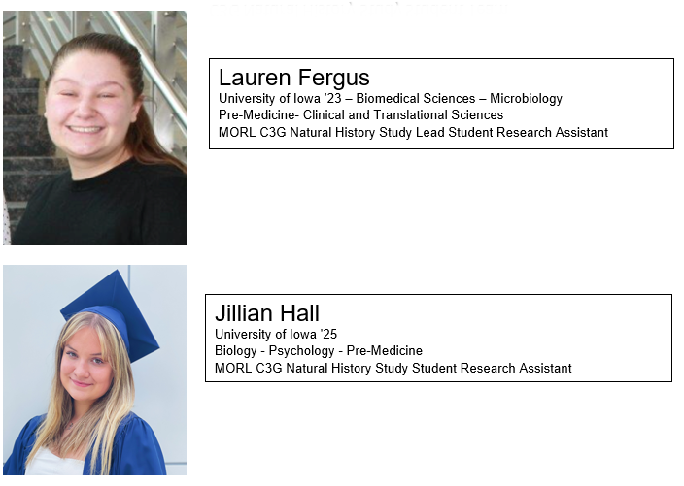
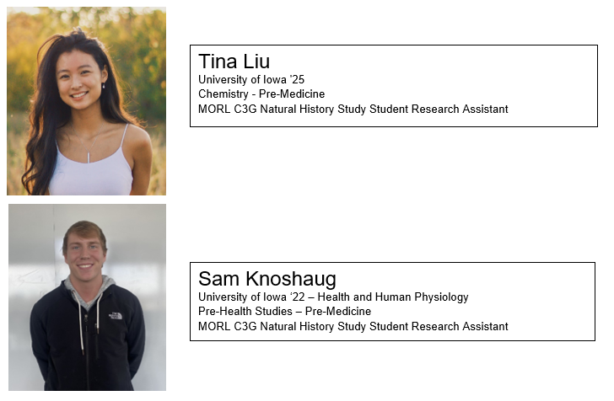
C3G Natural History Study Student Team
Notes:
This is our C3G NHxS STUDENT TEAM
Our students are key to inputting data into our RedCap Database.
In the summer each student worked 20-30 hours per week
When college is in session, they each work 8-17 hours weekly
Our C3G NHxS Student team is –
Lauren Fergus and Sam Knosbaug will be leaving us this summer
as they will be completing their senior year of Undergrad –
and on to their next endeavors……med school…..
Jill Hall and Tina Liu
are both completing their Sophomore years of undergrad and we are so pleased they will continue with us for several more years

Slide 13
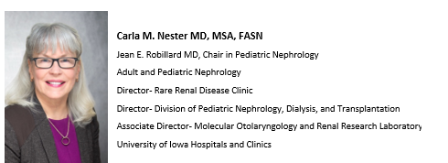
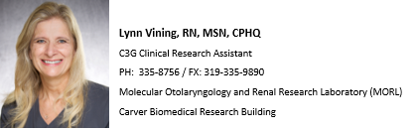
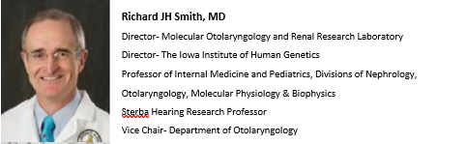
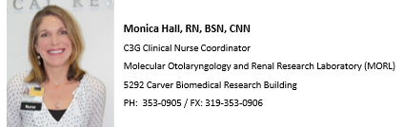
Sterba
Notes:
Here is our NHxS Administrative team – lead by Carla and Richard
Lynn is our Guru at Retrospective Data Collection as well as an expert in Excel.
Yuzhou is the lead scientist behind our team as well as our excellent Genetic and Functional teams.
Our Admin Associates Jori and Amy are the glue that holds us all together.

Slide 14
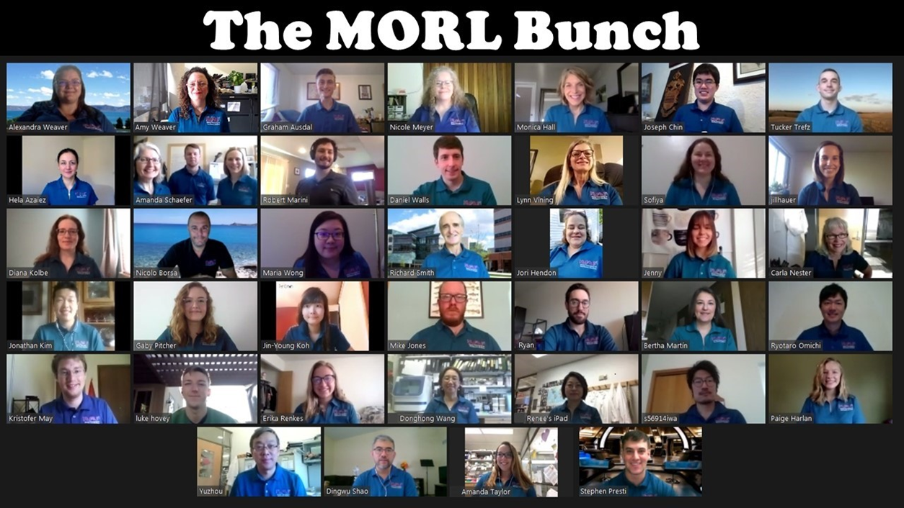
Notes:
Here is our entire team – the MORL Bunch
Our Family – all key to the success of our Study
And we thank each and every one their work with our Study.

Slide 15
Thanks for listening!
Any questions?

Slide 16
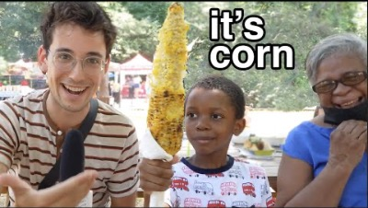
Notes:
Since we’re here in Iowa – I wanted to share a few Corn facts!
Iowa has approx. 87,000 farms
Ranks #1 in producing corn (as well as soybeans, hogs, eggs and ethanol)
On annual basis, Iowa farmers produce greater than 2.5 billion bushels of corn.
So, I thought I would end my presentation with a song from a little boy - talking about CORN
This is the most listened to and watched U-Tube video this SUMMER ☺

