Slide 1
The Future Treating C3 Glomerulopathy
Carla M. Nester MD, MSA, FASN
Jean E. Robillard MD, Chair in Pediatric Nephrology
Director, Division of Pediatric Nephrology, Dialysis and Transplantation
Associate Director, Molecular Otolaryngology and Renal Research Laboratory
C3 Glomerulopathy Family Support Group – October 2022

Slide 2
Disclosures
The following includes a list of current (within the last 24 months) affiliations:
Affiliation / Financial Interest | Organization
Associate Director | Molecular Otolaryngology and Renal Research Laboratory
NIH | 1R01DK110023-01A1
Site Investigator | ChemoCentryx
Site Investigator | Alexion Pharmaceuticals
Site Investigator, Advisory Board | Novartis
Site Investigator | Retrophin
Site Investigator, Advisory Board | BioCryst
Site Investigator, Advisory Board | Apellis
Data Safety Monitoring Board | Kira
Author Royalties | UpToDate
My conflicts are managed by a University of Iowa mandatory conflict plan.
Both prior and current relationships are on record at the University of Iowa’s Conflict in Research Office: https://coi.research.uiowa.edu/
Notes:
I am the PI in a number of clinical trials testing anti-complement therapeutics.
Since there are no targeted therapeutics I can prescribe – we have made it our mission to change that (by trial).

Slide 3
Objectives
Quickly review how to find a clinical trial
Understand inclusion and exclusion criteria for trials
Understand the features of a given trial
Quickly review published data on current trial agents

Slide 4
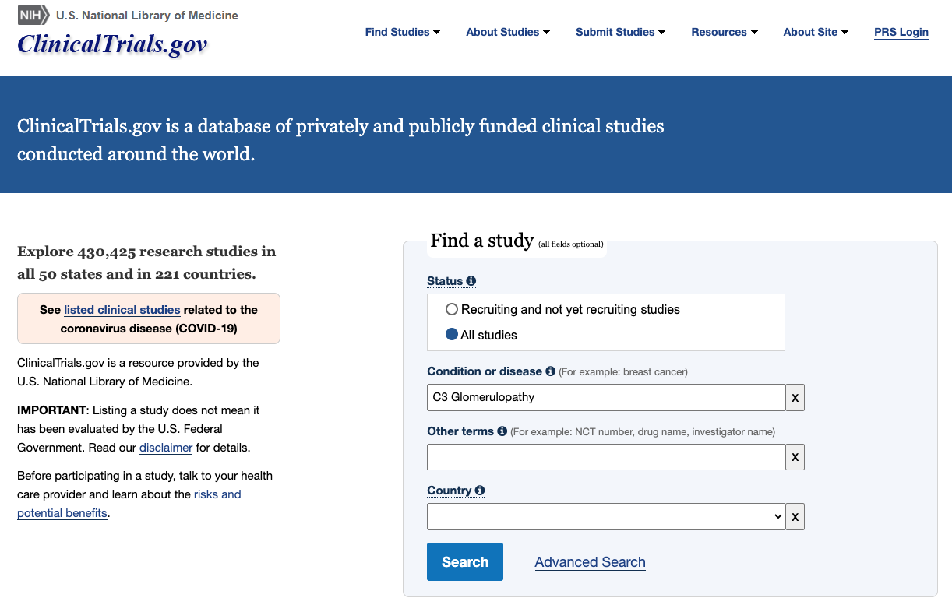
How to find a trial
Sample inclusions
C3G Biopsy
At least 1 gram of urine protein
eGFR >30
Stable medications
No complement drugs in last 6 months
Sample exclusions
Age (most are 12 and older)
Not all accept transplant
Urine protein too low
Too much scarring
eGFR below 30
https://clinicaltrials.gov/
Notes:
You can always call us.

Slide 5
How to find a trial:
https://clinicaltrials.gov/
Notes:
You can always call us.

Slide 6
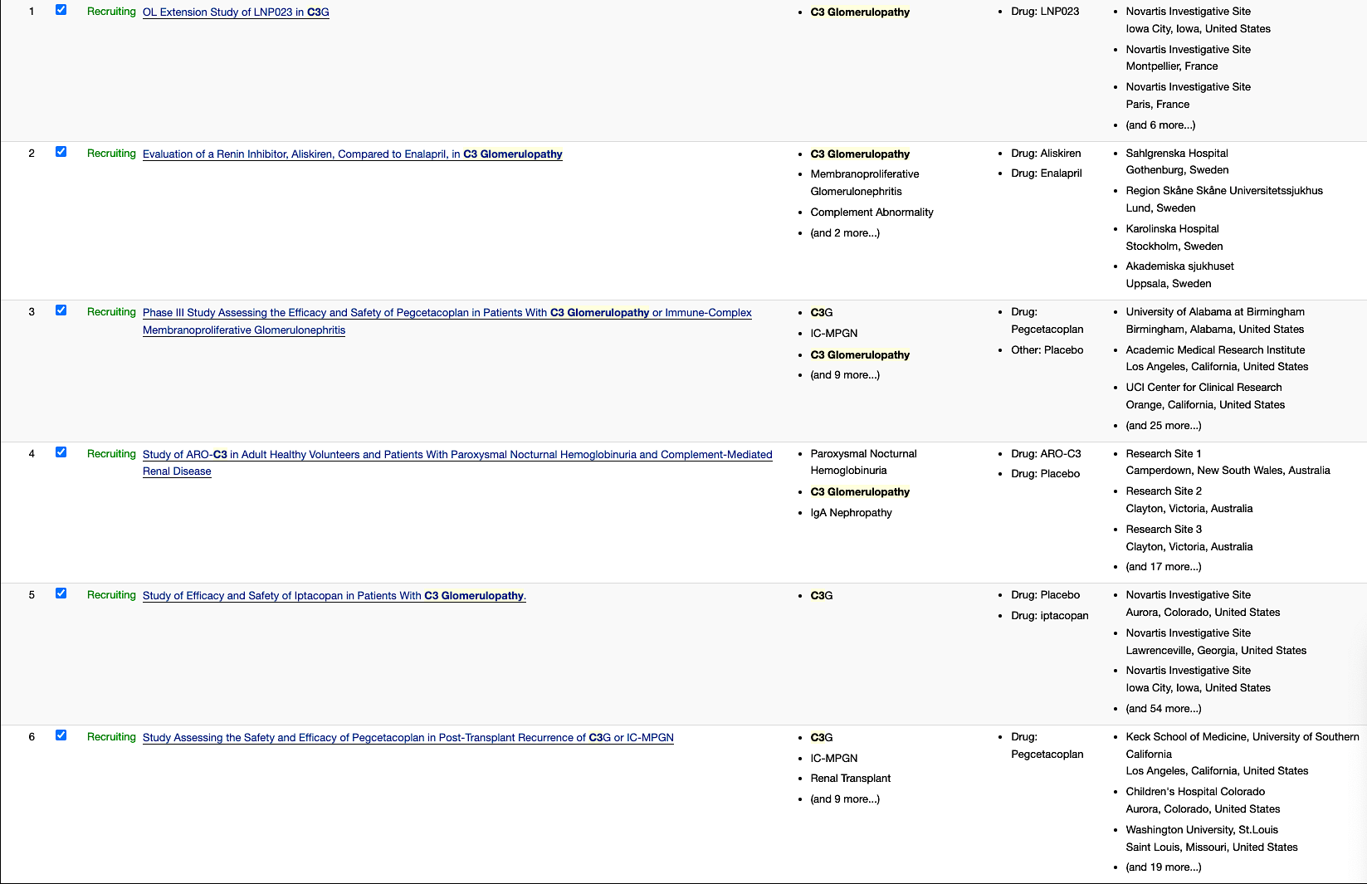

Slide 7
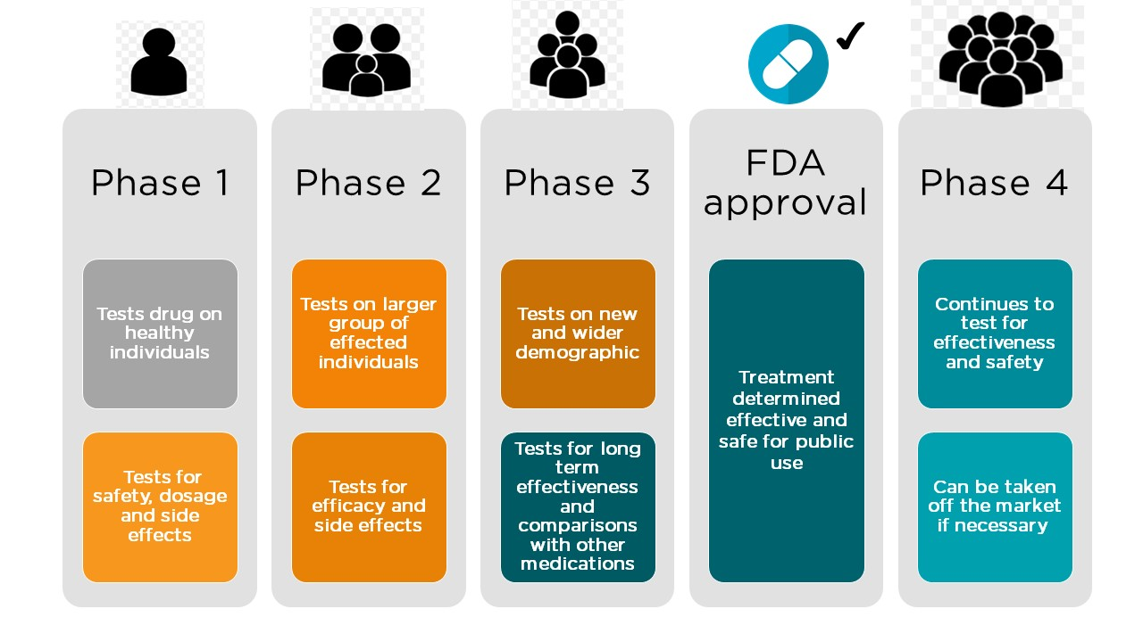

Slide 8
Alternative Pathway
C3
C3a
C3b
Factor D Inhibitor
Factor D
C3
Amplification
Loop
Factor B
Factor B Inhibitor
Ba
C3 Inhibitor
Y
Bb
C3 Convertase
C3b
DDD
C3b
H
+
I
Y
C3b
Bb
C3b
C5 Convertase
C3GN
C5 Inhibitor
C5
C6
C8
C9
C5a
C5b
C7
C5a Receptor Blocker

Slide 9
Alternative Pathway
C3
Negative Trial – Soon to be published in AJN
C3a
C3b
Danicopan
BCX9930
Single Arm – 5 Patients
74% UPCR reduction at 48 w
Significant increases in serum albumin and serum C3
Factor D
C3
Amplification
Loop
Factor B
Iptacopan
ASN 2020
Placebo Controlled (26 and 26) Main outcome: Change in -disease activity in a second kidney biopsy at 26 w
Results:
No significant change in activity
Significant improvement in eGFR
Significant decrease of UPCR and urinary MCP-1
Significantly less progression of chronicity lesions
Ba
Single Arm
Cohort A (n=16) Native kidneys: Proteinuria reduction at 12w.
Cohort b (n=11) Transplant: Change in C3 IF at 12 w
Results:
45% proteinuria reduction in Cohort A
Significant decrease of C3 deposit score in Cohort B
Pegcetacoplan
Y
Bb
C3b
C3 Convertase
C3b
H
+
I
Y
C3b
Bb
C3b
C5 Convertase
C5
C6
C8
ASN 2021
C5b
C9
C5a
C7
EDTA 2021
Avacopan
Notes:
Data is mostly available in abstract form
It is worth noting that Pegcetacoplan is probably the farthest ahead in safety data collection
Many other options are coming

Slide 10
Alternative Pathway
Complement Blockade
C3
C3a
Apellis:
Phase III Subcutaneous Infusion
Twice weekly
13yo and up
Includes Tx
BioCryst:
Phase II/III? open
in Europe
Oral
Twice daily
18yo and up
C3b
Factor D Inhibitor
Factor D
C3
Amplification
Loop
Factor B
Ba
Factor B Inhibitor
C3 Inhibitor
C3 Inhibitor
Y
C3b
Bb
C3 Convertase
Novartis:
Phase III
Oral
Twice daily
18yo and up
Arrowhead
Phase I/II
D1, D85 sq Injection
C3b
H
+
I
Y
C3b
Bb
C3b
C5 Convertase
C5 Inhibitor
C5
Eculizumab
Ravulizumab
C6
C8
C9
C5a
C5b
C7
C5a Receptor Blocker
Notes:
Strongly encourage you to go to clinical trials.gov: 15 studies
Phase III means placebo
Only going to talk about AP blockers

Slide 11
Thank You
Good Health To All!

