Slide 1
C3 Glomerulopathy Current Cares
Carla M. Nester MD, MSA, FASN
Jean E. Robillard MD, Chair in Pediatric Nephrology
Director, Division of Pediatric Nephrology, Dialysis and Transplantation
Associate Director, Molecular Otolaryngology and Renal Research Laboratory
C3 Glomerulopathy Family Support Group – October 2022

Slide 2
Disclosures
The following includes a list of current (within the last 24 months) affiliations:
Affiliation / Financial Interest | Organization
Associate Director | Molecular Otolaryngology and Renal Research Laboratory
NIH | 1R01DK110023-01A1
Site Investigator | ChemoCentryx
Site Investigator | Alexion Pharmaceuticals
Site Investigator, Advisory Board | Novartis
Site Investigator | Retrophin
Site Investigator, Advisory Board | BioCryst
Site Investigator, Advisory Board | Apellis
Data Safety Monitoring Board | Kira
Author Royalties | UpToDate
My conflicts are managed by a University of Iowa mandatory conflict plan.
Both prior and current relationships are on record at the University of Iowa’s Conflict in Research Office: https://coi.research.uiowa.edu/
Notes:
I am the PI in a number of clinical trials testing anti-complement therapeutics.
Since there are no targeted therapeutics I can prescribe – we have made it our mission to change that (by trial).

Slide 3
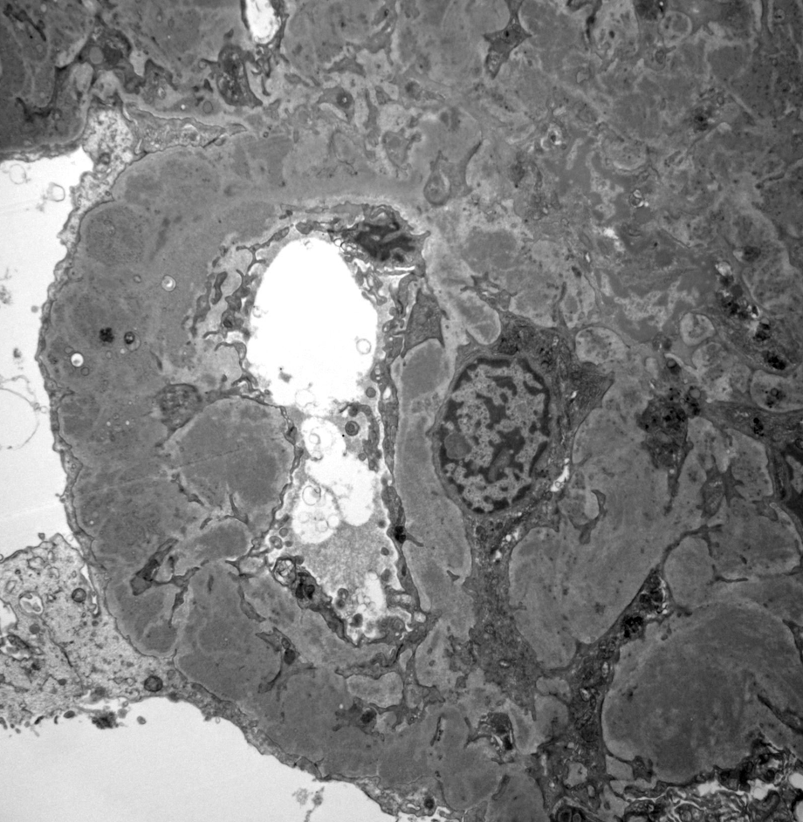
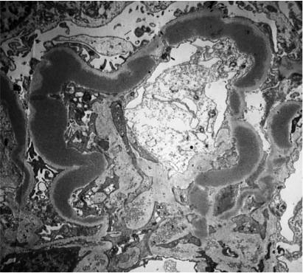
Nomenclature
C3 Glomerulopathy
Term used to designate a disease process
C3 Dominant Glomerulonephritis (Glomerulonephritis with dominant C3 )
The pathologic description of C3G AND “PIGN”
C3 Glomerulonephritis
One of two types of C3G
Dense Deposit Disease
Kidney Int. 2013 Dec;84(6):1079-89
Notes:
Dr. Nast has already discussed the pathology – lets just review the terminology very quickly

Slide 4
Objectives
Recognize the initial approach to C3 Glomerulopathy
Understand when mycophenolate mofetil (MMF) and steroids should be considered
Brief review of pros and cons of steroids
Understand indication for when care should be escalated

Slide 5
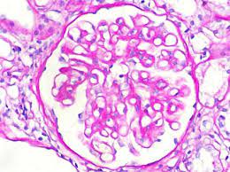
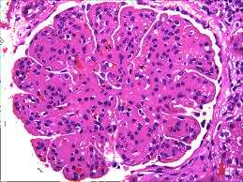
How C3G Patients Present
Clinical presentation of glomerulonephritis (hematuria, proteinuria, HTN, etc)
Can be confused with other causes of hematuria, proteinuria or hypertension
Ruling out infection related disease is crucial:
Renal biopsy that meets diagnostic criteria – and has been taken at least 12 weeks after purported infection.
(C3G and PIGN biopsies are indistinguishable)
Goal: rule out normal complement activation process

Slide 6
Paraprotein Related C3 Glomerulopathy
Paraproteins are abnormal proteins made by a “rogue” cell in your body.
Usually occurs in someone older than 50
Can dysregulate the complement pathway (kind of like nephritic factor)
Monoclonal gammopathy of renal significance (MGRS)
Incidence varies: 33-83%
Am J Kidney Dis. 2010 Nov;56(5):977-82
Treating the paraprotein gives better renal survival
KDIGO guidelines support evaluating for the presence of a paraprotein in ALL patients who present with C3G for the first time over the age of 50.
Blood. 2017;129(11):1437-1447
Notes:
Serum immunofixation most sensitive
Serum protein electrophoresis is quantitative and inexpensive. UPEP less sensitive
Serum free light chain

Slide 7
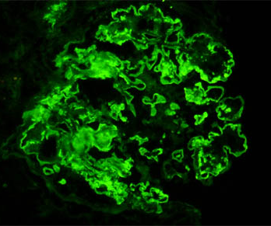
Controversies related to diagnosing C3G
Does not have to be “isolated” C3 deposits
Hou et al.: 41% of cases have C3 only, IgM is often “trapped” in this setting (59%)
Light microscopy pattern is variable (absence of MPGN pattern is common).
Ruling out infection related disease is crucial:
Renal biopsy that meets diagnostic criteria – and has been taken at least 12 weeks after purported infection.
(C3G and PIGN biopsies are indistinguishable)
Goal: rule out normal complement activation process
The Biopsy may not be static: C3G →← MPGN (ICGN)
(8% of repeat biopsies went from ICGN to C3G)
Kidney Int. 2014 Feb;85(2):450-6

Slide 8
Current Recommendations for Treatment
All patients should receive supportive cares Optimal blood pressure control Optimal nutrition for both normal growth in children and healthy weight in adults
In the absence of a monoclonal gammopathy, consider treating patients with: >1g/d of urine protein Declining kidney function (over 6 months)
Initial treatment: Mycophenolate mofetil + steroids If above fails – consider eculizumab Consider for clinical trial
Chapter 8
Not based on trial data
Retrospective
Generic approach: a trial of things that were used in other glomerular diseases
Limited availability of “targeted” therapeutics
Kidney International (2021) 100, 753-779
Notes:
New KDIGO guidelines coming which will say essentially the same thing.

Slide 9
Renal Response to Current Cares
Current cares are guideline based
Doses and duration vary
No guideline for dose and duration of steroids
Follow-up is variable
Criteria for response is variable
Response highly variable across studies
Notes:
Rabasco C et al. Kidney Int. 2015; 88(5): 1153–60.
Avasare RS et al. CJASN. 2018; 13(3): 406–13.
Caravaca Fontan F et al. CJASN 2020; 15: 1287–1298.
Bharati J. Clinical Kidney Journal, 2019; 12: 483–487
Caliskan Am J Nephrol 2017;46:96-107
Khandelwal Pediatric Nephrology (2021) 36:591–600
Ravindran 2018 Mayo Clin Proc. 2018;93(8):991-1008

Slide 10
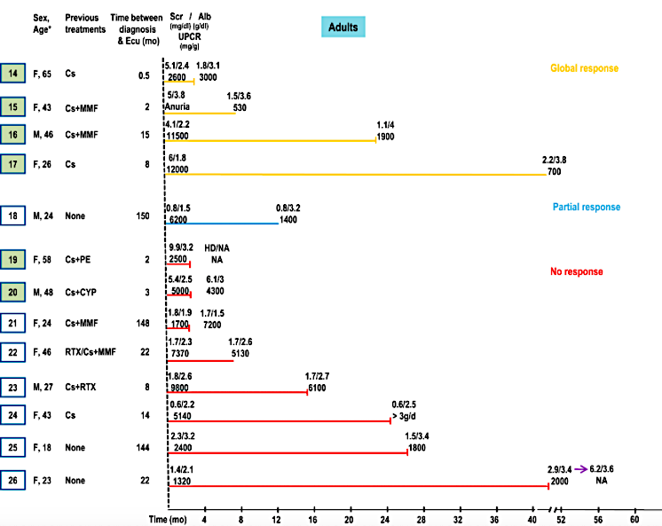
Eculizumab and C3G
6/26 complete remission
1/26 partial remission
Response was not predicted by sMAC (C5b-9)
“While eculizumab can be tried in patients who fail to respond to MMF, such patients should be considered for clinical trials where available”
No reason to think that the response to Ravulizumab would be different
Am J Kidney Dis. 2018 Jul;72(1):84-92
Notes:
Earlier study in US – 6 patients – 3 appeared to have some degree of response.
Responders appeared to be predicted by elevated sMAC

Slide 11
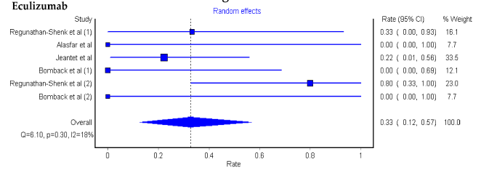
Treatment Effect – Allograft Loss
122 patients: (73 C3GN, 49 DDD)
33% tx loss after ecu
22% C3GN and 53% DDD)
42% after TPE
81% after Ritux
No Rx
32% C3GN
53% DDD
Gonzalez Suarez et al, Med. Sci 2020, 44

Slide 12
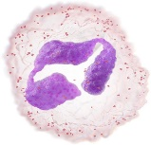
Current Therapeutic Approach
Alternative Pathway
C3
C3a
C3b
Factor D
Steroids + Mycophenolate
C3
Amplification
Loop
Factor B
?
Ba
Y
Bb
C3b
C3 Convertase
DDD
C3b
?
Terminal Complement Blockade
Y
Bb
C5 Convertase
C3b
C3b
C3GN
C5
C6
C8
C9
C5a
C5b
C7
Membrane Attack Complex
Notes:
Given the underlying pathomechanism, current therapeutics may have a limited direct effect on disease.
None the less – theories on why they may work

Slide 13
General rule of thumb for escalating care
Despite Current Cares:
Increasing urine protein (generally >1g/d) or creatinine
Advancing histology
Increasing symptoms
Trial of at least 6 months of current cares
Lowest duration possible for steroids (ie <12 weeks in children)
Inability to tolerate current cares

Slide 14
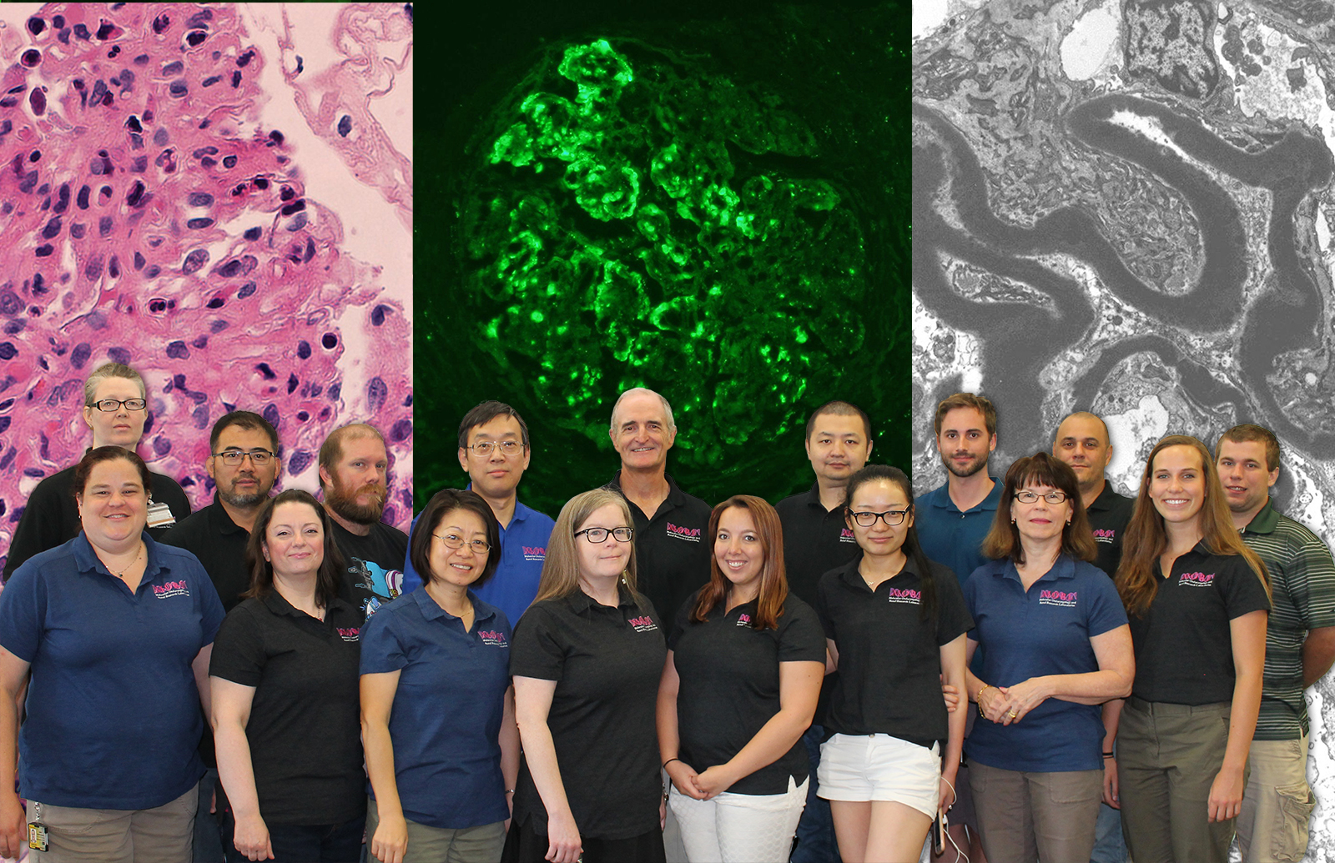
Division of Pediatric Nephrology\
Molecular Otolaryngology and Renal Research Laboratory
I’m very thankful to have Two “Work” Families

Slide 15
Thank You
Good Health To All!

