Slide 1
COVID-19 and C3G
Christie P Thomas

Slide 2
Learning objectives
Learning objectives
To review the emergence of the pandemic and the timeline of important events
To understand how C3G patients with native kidneys or transplants fare with COVID
To review COVID19 and vaccination and its safety for C3G patients
To understand how you may/should be treated if you get COVID and have a transplant

Slide 3
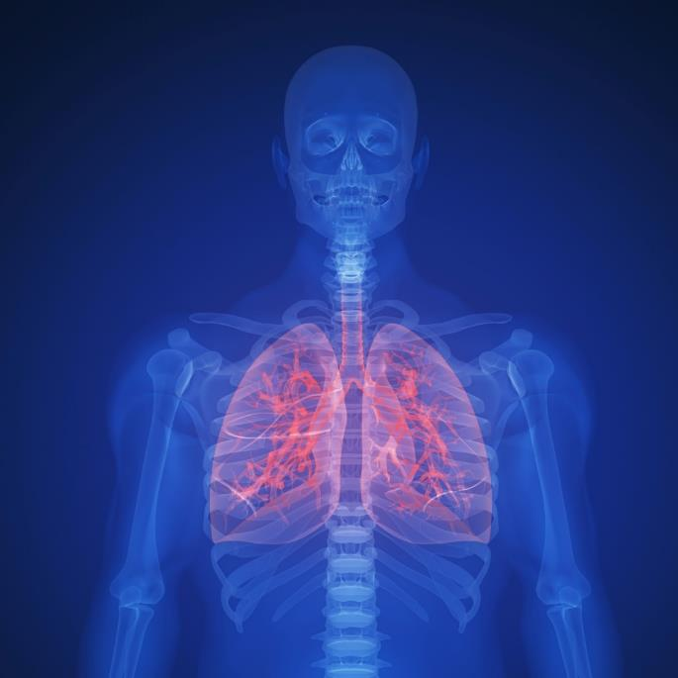
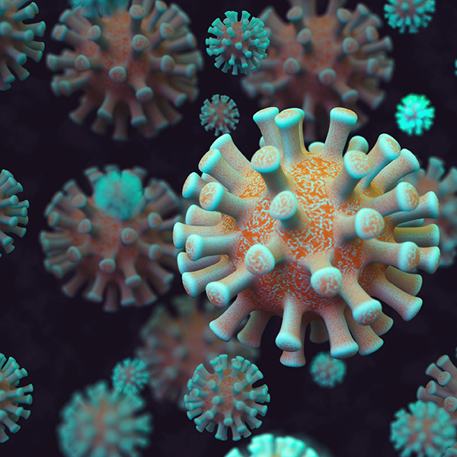
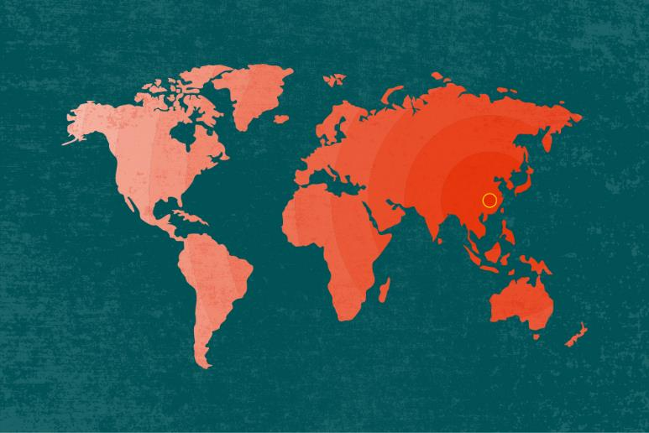
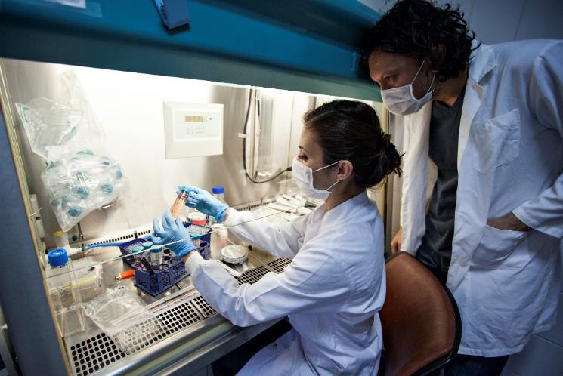
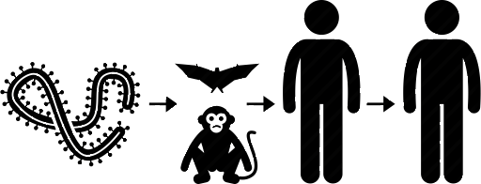
What is COVID-19?
The 2019 novel coronavirus infection is a respiratory infection caused by a virus
SARS-CoV-2 is the name of the virus, COVID-19 is the disease it causes
Related to SARS and MERS
Causes respiratory symptoms including fever, cough and shortness of breath, and can lead to pneumonia
Identified in December 2019 in Wuhan, China and has spread globally
Believed to have originated from an animal host and is now spreading via human-to-human transmission
Notes:
CDC believes the symptoms of COVID-19 may appear in as few as 2 days or as long as 14 days after exposure.
Virus is 95% the same as one observed in bats and likely originated in bats.
State and local public health departments have received diagnostic tests from CDC while medical providers are getting tests developed by commercial manufacturers. All of these tests are Real-Time Reverse Transcriptase (RT)-PCR Diagnostic Panels, that can provide results in 4 to 6 hours.
There is no vaccine or treatment as of April 1, 2020.
Certain experimental therapeutics, such as convalescent plasma and anti-malarial drugs, have been FDA-approved as emergency treatments.

Slide 4
COVID-19: A Timeline
WHO Officials announce they have identified a new virus, named 2019-nCoV and is identified as belonging to the coronavirus family, which includes SARS and the common cold.
The WHO reports the first case outside of China (Thailand) in a traveler who had visited Wuhan.
Dec. 31, 2019
Jan. 11
Jan. 20
Jan. 7 2020
Jan. 13
A Chinese expert on infectious diseases confirmed human-to-human transmission to state broadcaster CCTV.
China alerts WHO to several cases of unusual pneumonia in Wuhan.
China announces its first death from the virus.

Slide 5
COVID-19: A Timeline
NIH scientists began a randomized controlled trial of the antiviral drug remdesivir that had been developed for Ebola, on a patient infected with SARS-CoV-2. This is the first clinical trial in the U.S. for an experimental treatment for COVID-19
The WHO announces that the new coronavirus would be called "COVID-19".
Jan. 30, 2020
Feb. 25
Feb. 11
Feb. 5
WHO declares coronavirus a global emergency with cases being reported in the United States, Japan, Nepal, France, Australia, Malaysia, Singapore, South Korea, Vietnam and Taiwan.
CDC warned that disruptions to the U.S. from COVID-19 could be severe. The agency expects the disease to begin spreading at the community level in the U.S

Slide 6
COVID-19: A Timeline
After more than 118,000 cases in 114 countries and 4,291 deaths, the World Health Organization declares the coronavirus outbreak a pandemic, acknowledging that the virus will likely spread to all countries on the globe.
The FDA allows treatment of life-threatening COVID-19 cases with convalescent plasma.
Feb. 29, 2020
Mar. 16
Mar. 11
Mar. 24
The FDA took steps to expand novel coronavirus testing to hospital clinical microbiology laboratories.
The CDC recommends that for the next 8 weeks, organizers cancel or postpone in-person events that consist of 50 people or more throughout the United States.

Slide 7
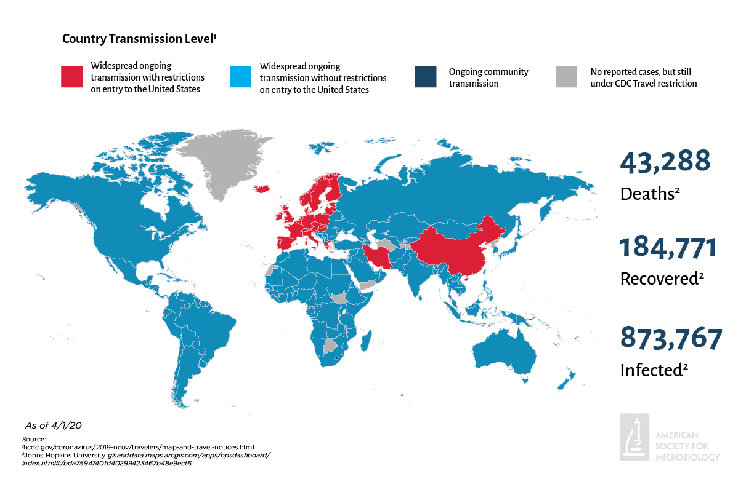
Global Spread is Expected to Continue
Apr 1, 2020
Notes:
Virus spreads from human to human via close contact or contact with contaminated objects.
Human to human transmission is significant because it means one does not need to be in contact with the original zoonotic source.
The earlier we test for coronavirus infection, the faster someone can be isolated and given the appropriate therapy.
At this time (March 2, 2020), it’s unclear how easily or sustainably the virus that causes COVID-19 is spreading between people.
On Thursday, January 30, WHO Declared Coronavirus A Global Health Emergency.
Tuesday, Jan. 21: The CDC confirmed first case of the coronavirus in the U.S. in an individual who visited Wuhan.
On February 11, 2020 the World Health Organization announced an official name for the disease COVID-19.
Tuesday, Feb. 25: CDC has warned that disruptions to the U.S. from COVID-19 could be severe. The agency expects the disease to begin spreading at the community level in the U.S
Wednesday, Feb. 26: NIH scientists began a randomized controlled trial of the antiviral drug remdesivir that had been developed for Ebola, on a patient infected with SARS-CoV-2. This is the first clinical trial in the U.S. for an experimental treatment for COVID-19
Thursday, Feb 27: C.D.C. Confirms Possible Community Transmission Case in US
Sunday, March 1: There have now been 2 deaths from COVID-19 in Washington State. Six cases have been confirmed at a nursing home in the Seattle Suburb of Kirkland.
Monday April 1: Cases of COVID have been reported in all US states. Ove 870,000 cases have been reported globally, with the US having the most reported cases (nearly 190,000).

Slide 8
COVID-19: A Timeline
More than 1 million COVID-19 vaccine doses were administered in the U.S. in just 10 days: healthcare workers and older adults living in long-term care facilities are the first to be vaccinated.
The number of confirmed COVID-19 cases in the U.S. surpasses 2 million.
May. 28, 2020
Nov. 16
June. 10
Dec. 24,2020
The recorded death toll from COVID-19 in the U.S. surpasses 100,000.
Moderna’s COVID-19 vaccine is found to be 95.4% effective in its clinical trial.

Slide 9
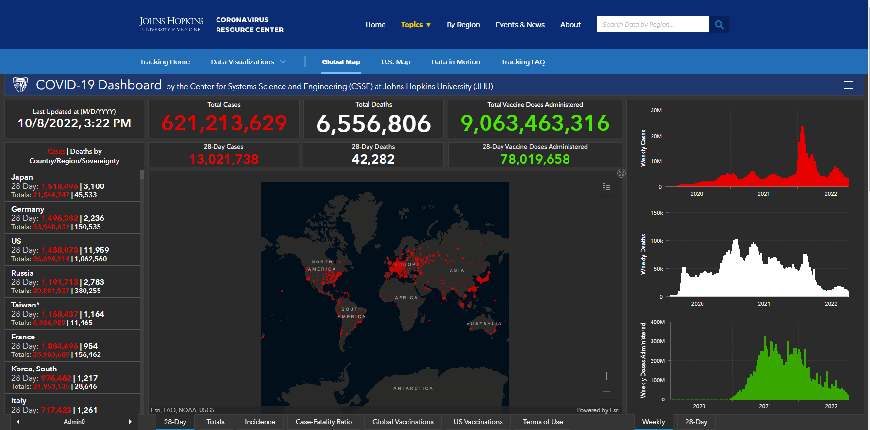
COVID19 today
~600 million cases, 6.5 million death, 9 billion vaccine doses
https://coronavirus.jhu.edu/map.html

Slide 10
Treatment
In the beginning:
Early 2020: Dexamethasone
March 30, 2020: FDA issues EUA for hydroxychloroquine (already in use for lupus and other conditions)
May 1, 2020: FDA issues EUA for remdesivir (antiviral developed for Ebola)
June 4, 2020: Lancet and NEJM retract studies on hydroxychloroquine
August 23, 2020: FDA issues EUA for convalescent plasma
November 9, 2020: FDA issues EUA for monoclonal antibody, banlanivumab
November 21, 2020: FDA issues EUA for monoclonal antibody combination, casirivimab and imdevimab (REGN-COV2)
March 27,2021: FDA issues EUA for monoclonal antibody, sotrovimab
Today, none of these drugs (except dexamethasone and remdesivir) are in use
Notes:
The first postoperative serum phosphorus obtained on day 1 was 5.3 mg/dl.

Slide 11
Sars-CoV2 variants
Some others
Epsilon (B.1.427 and B.1.429)
Eta (B.1.525)
Iota (B.1.526)
Kappa (B.1.617.1)
Mu (B.1.621, B.1.621.1)
Zeta (P.2)
Omicron lineage subvariant BA.5 makes up 80% of today’s isolates in the US

Slide 12
Treatment today - Antivirals
Outpatient
Oral:
Nirmatrelvir + ritonavir (Paxlovid): > 12 yr and onset no more than 5 days ago
or
Molnupravir (Lagevrio): > 18 yr and onset no more than 5 days ago: 800 mg po x 5 days
IV:
Bebtelovimab: onset no more than 7 days ago
or
Remdesivir (Veklury): onset no more than 7 days ago. IV daily for 3 days
Eligibility
COVID-19 positive and symptomatic but not hospitalized
High risk for progression

Slide 13
Treatment today - Antivirals
Hospitalized
Baricitinib
Remdesivir
Other
Tocilizumab
Dexamethasone

Slide 14
Prevention (PrEP)
Tixagevimab co-packaged with cilgavimab (Evusheld)
Eligibility
Not currently infected with COVID19
Not recently exposed to someone with COVID19
Generally given to people at high risk for serious COVID19

Slide 15
High risk for covid progression
> 65 yr
Obesity (BMI ≥30 kg/m²)*
Cancer
Cerebrovascular disease, Chronic kidney disease, lung disease or liver disease*
Diabetes mellitus, type 1 and type 2*
Disabilities*
Heart disease (such as heart failure, coronary artery disease, or cardiomyopathies)
HIV (human immunodeficiency virus)
Immunocompromised or use of immunosuppressive medications
Mental health disorders*
Dementia
Pregnancy and recent pregnancy
Physical inactivity

Slide 16
COVID19 in Dialysis Patients
Prior to vaccination (original strain of virus)
20-fold higher prevalence of disease compared to overall population
50% of recipients needed hospitalization and 20-30% mortality
Lower risk for disease with at home dialysis
Post vaccination (and against variant strains – delta and omicron)
90% of vaccine recipients develop antibodies

Slide 17
COVID19 in Kidney Transplant Recipients
Prior to vaccination (original strain of virus)
90% of transplant recipients needed hospitalization
30% mortality
Post vaccination (and against variant strains – delta and omicron)
In one study – 50% of recipients needed hospitalization and 5-10% mortality
Overall:
Excess mortality rate in US population (26 per 10,000)
Excess mortality rate in kidney transplant recipients (188 per 10,000)
.
Clark et al., Transplantation 2022 Aug 31. doi: 10.1097/TP.0000000000004341

Slide 18
COVID19 vaccines
Vaccine types
mRNA: Moderna, Pfizer (2-3 doses) – Full FDA approval
Viral vector: J&J – FDA EUA; Other countries: AstraZeneca (Oxford), Sinopharm, Sinovac, Covaxin
Protein subunit vaccine: Novavax – FDA EUA
Vaccine response
Antibodies against the virus (Spike protein)
Development of T cell immunity (harder to measure)
Vaccine effectiveness
Prevention of infection/transmission
Prevention of hospitalization
Prevention of death

Slide 19
COVID19 mRNA vaccines
Effectiveness and vaccine response in general population
~95% effective against preventing hospitalizations and death
~100% of vaccinated people have robust antibodies
Effectiveness in dialysis patients
Not enough data to know about effectiveness
~90% of vaccinated people have robust antibodies

Slide 20
mRNA vaccine in transplant patients
After 1st dose
5% had antibody response
After 2nd dose
40% of a patients had antibody response
After 3rd dose
45% of negative patients developed an antibody response
A total of 70% had antibody after 3rd dose
CDC recommends a 4th dose (2nd booster) for immunosuppressed patient
In one study 19% had no antibody after 4th dose
CDC recommends an additional bivalent booster on top of prior monovalent vaccines
Pfizer-BioNTech and Moderna

Slide 21
COVID19 vaccination and GN
Case series of 13 patients with data on disease after vaccination:
8 with newly diagnosed GN and 5 with relapses
5 had IgA and 3 had membranous and 2 had minimal change disease
Additional 20 articles reporting on 27 cases
13 with newly diagnosed GN and 14 with relapses
11 had IgA and 10 had minimal change disease
Recent study from Switzerland using a nationwide cohort showed no increase with vaccination
Note:
Other vaccines are also reported to be associated with new or relapsed GN
COVID19, the disease, also reported to be associated with new or relapsed GN
My take:
Possibly a true association, but given the rarity, more likely a fortuitous occurrence
Klomjit et al., Kidney Int Reports 2021, 6:2969-2979
Diebold et al., Kidney Int 2022, doi: 10.1016/j.kint.2022.08.021

Slide 22
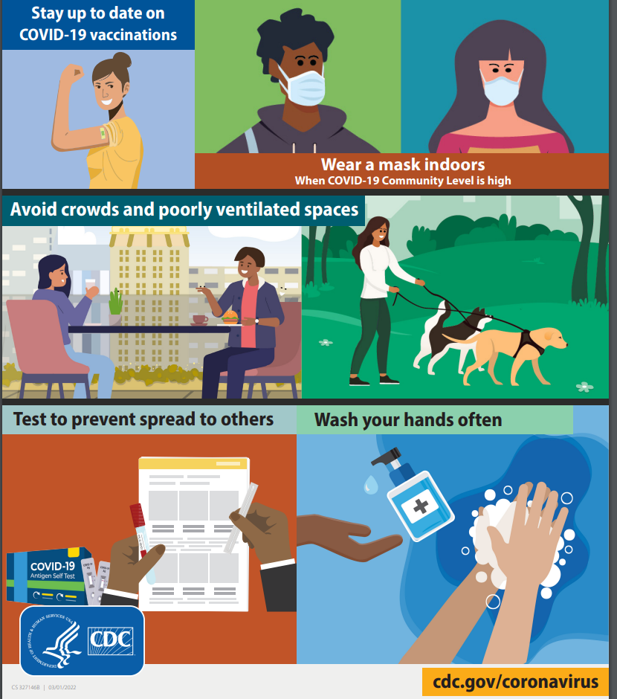
Options in transplant and other immunosuppressed recipients
Obtain primary vaccination series against COVID19: mRNA vaccines preferred
Continue to mask around unvaccinated people
Maintain social distancing
Consider Evusheld for preexposure prophylaxis especially if high risk occupation
Seek medical attention early if symptoms develop
Outpatient Rx if symptomatic: Bebtelovimab (monoclonal antibody) or Paxlovid
Avoid Paxlovid if on tacrolimus
Paxlovid not recommended if eGFR is <30 mL/min
Take additional booster shots when recommended
Must have finished the primary series
Wait at least 2 months since primary or last booster
Current booster: bivalent (effective against original strain and against Omicron variants)
Pfizer-BioNTech – one dose in age > 12
Moderna – one dose in age > 18
https://www.cdc.gov/coronavirus/2019-ncov/index.html

Slide 23
Questions?

Slide 24
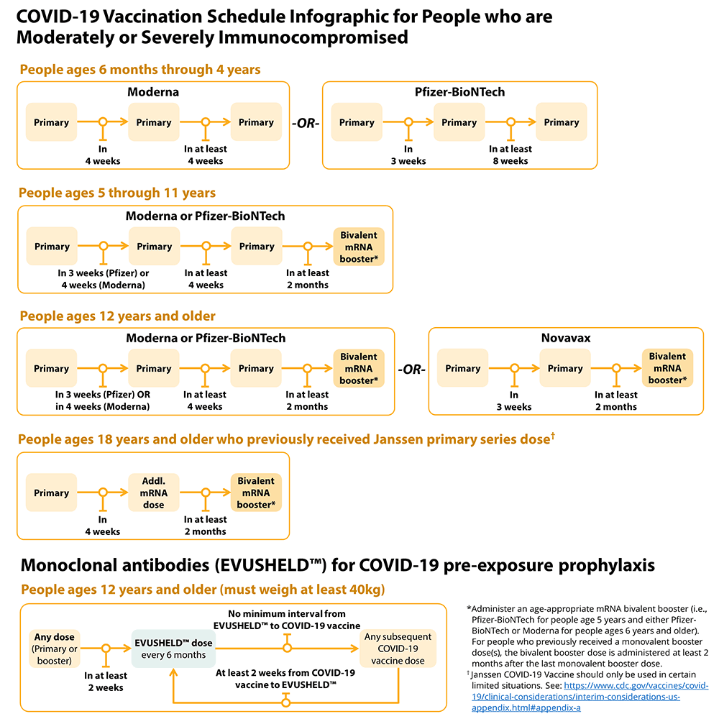
NKF

