Slide 1
Coping with Chronic Illness
Kidneeds
C3G Family Conference
15 October 2022
Claire McKinley, MD

Slide 2
Overview
Grief and coping with chronic illness
Differences in grief and coping: children, teens, adults
Signs of a need for professional services
Tools and resources for support

Slide 3
Grief: Coping with a Chronic Illness

Slide 4
“Typical” Grief
Notes:
“5 Stages of Grief”
Elisabeth Kubler Ross – not really intended to be linear

Slide 5
“
The reality is that you will grieve forever. You will not ‘get over’ the loss…you will learn to live with it… You will be whole again but you will never be the same. Nor should you be the same.
“
Notes:
Elisabeth K-R, MD
So there’s no timeline…but what’s normal? We’re going to get to that in a later slide, but the quick answer is “clinically significant distress or impairment” lasting more than 6-12 months, depending who you ask. This does assume a single incident (like a death) rather than an ongoing stressor (like a chronic illness).

Slide 6
Grief and Coping: Children, Teens & Adults

Slide 7
Expressions of Grief
Children
Teens
Adults
“Magical thinking”
Guilt
Cure
Regression
Anxiety
“People pleasing”
Embarrassment/shame
Embarrassment/shame
Humor (in excess)
Taking adult roles
Risky behavior
Easily distracted
Thoughts of death or suicide
Anger outbursts
Guilt
Appeasement
Numbness
Controlling behaviors
Notes:
Withdrawal, anger, changes in eating or sleeping, somatic symptoms
Thoughts of death/suicide are always scary but they aren’t a monolith. They definitely belong in the “seek more help” category but I put them here to highlight that this is most common/most relevant to adolescents vs other groups given relative population risk of attempted/completed suicide

Slide 8
Typical Developmental Tasks
Infancy
Trust vs mistrust
Toddlerhood
Autonomy vs shame
Preschool
Initiative vs guilt
School age
Industry vs inferiority
Teens
Identity vs confusion
Early adulthood
Intimacy vs isolation
Middle age
Generativity vs stagnation
Late life
Integrity vs despair
Erikson’s Stages of Psychosocial Development
Notes:
Everyone goes through these. There’s many ways to delineate them but I like this one. As before, they’re not as neat and orderly as they look here – you can definitely skip pieces but this is not healthy and you will have a progressively harder time in life as you go along.
The task of coping with the diagnosis AND MANAGEMENT of a chronic illness is unfolding across the backdrop of these typical conflicts that everyone experiences, and they affect each other.
There are other models besides Erikson. The point is, there is a reason why kids at certain ages respond to challenges in the way they do. It is very easy for an adult caregiver to forget about this or think that the kid’s interests and priorities are trivial in the face of this huge life-altering diagnosis. Fight this temptation.

Slide 9
Industry vs Inferiority
Child faces increasingly complex tasks; by facing and completing them the child develops patience and self-belief
Roughly ages 6-12
School, teachers and peers important
Often academically focused
Child may feel ashamed of differences from peers
Notes:
Facing increasingly complex tasks and more frustration than previous. Goal is to develop “industry,” aka patience, and a sense that the child can master (appropriate) challenges with the right combination of patience and sustained effort. Kids should be age-appropriately involved in their care, especially the day to day tasks like taking medicine, tracking potassium intake, etc.
If your child is having to miss school, falling behind, having cognitive “fog” from dialysis/ESRD: find ways to praise effort over outcome, but also acknowledge differences. Find something (preferably effort-related) that your kid is good at or interested in and can work to improve: music? Art? Taking care of animals? Niche interests they can develop (dinosaurs, memorizing all the presidents, advancing their reading level)

Slide 10
Identity vs Confusion
Developing a sense of self that is separate from the family unit. Preparing for adult relationships and responsibilities. “Who am I?” “Who do I want to be?” “What are my values?”
Peers increasingly important
Some degree of rebellion is typical and healthy
Social media is a potential pitfall
Notes:
Development of identity (psychologically speaking) is a lifelong process, but you’re laying the groundwork in your teens. Healthy family framework is key – boundaries about strong values and non-negotiables + openness to the teen “trying on” new/different opinions and values from those of the parents.
Still can have challenges feeling ‘different’ from peers.
For teens with chronic illness, crucial items like meds and diet can become power struggles – avoid this when possible. If symptoms/management needs developed earlier, matter-of-fact involvement of your kid in their care can alleviate some of this. Hardest when the illness (or specifically the need for lifestyle changes like meds, diet management, etc) begins during this stage. The goal is not to avoid rebellion or to exact perfect compliance, it’s to give your kid appropriate freedom to manage his life (…and hopefully direct the rebellion into something else).

Slide 11
When to Consider Additional Support
Notes:
“Clinically significant distress or impairment”
Power struggles
Suicide/thoughts of death (panic stations vs seeking help)

Slide 12
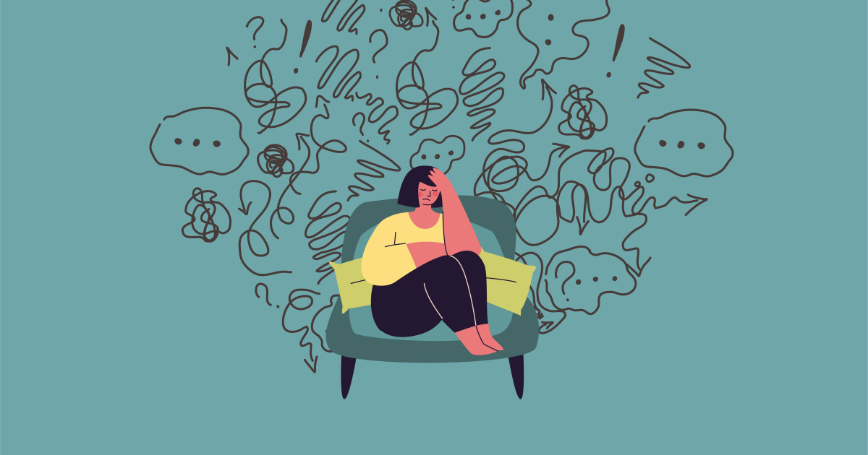
Warning Signs
Grief or behavior changes seem to last longer than 6 months
Any “clinically significant distress or impairment”
Power struggles
Younger age at diagnosis
Thinking about death

Slide 13
Professional Support
Earlier is Better
Focus on Transitions
For the Whole Family
Power STruggles
Thoughts of Death
Age at diagnosis
Problem course
School transitions
“Big” birthdays
Disease transitions
Individual therapy for siblings
Therapy or other support for parents
Family therapy
OR Everybody in individual therapy
Ask and listen to involve the right expert

Slide 14
Tools and Resources

Slide 15
General Education (Mental Health)
www.kidshealth.co.nz
- Reader-friendly info on child development
www.nhs.uk
“Health A-Z”
“Medicines A-Z” (use generic names)

Slide 16
“Find a Therapist”
www.psychologytoday.com
- “find a therapist”
- filter by location
The best way to find a therapist is still word of mouth: from your doctor or your friends

Slide 17
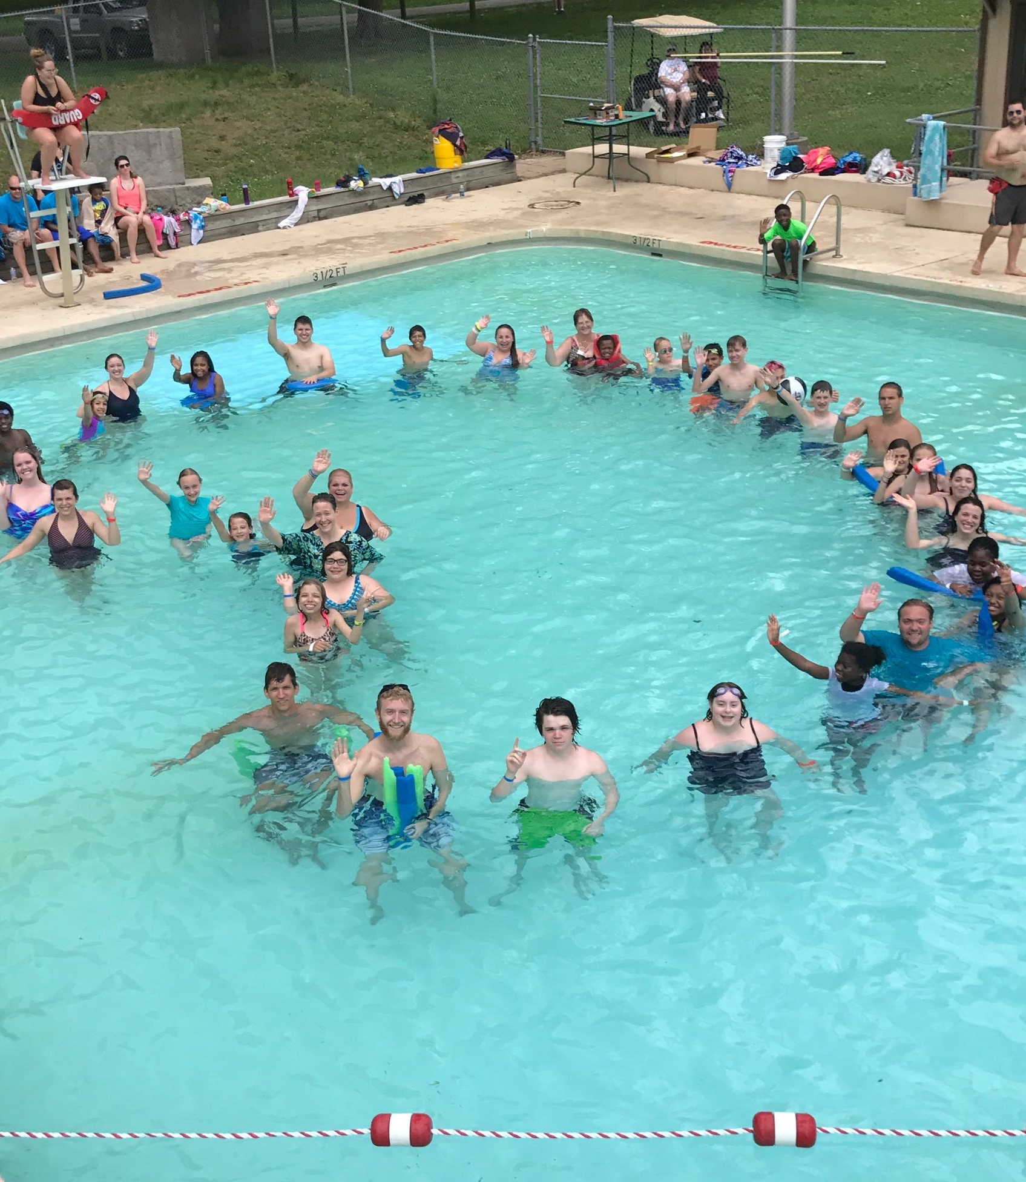
Peer Support
aakp.org (US)
www.kidney.org/peers (US)
www.rsnhope.org

Slide 18
Summary
Grief and coping is different for everyone, and especially different for different age groups
Help your child find ways to challenge themselves and grow
Know your resources before you need them
When thinking about support, consider everyone in the family
Earlier is better (resources permitting)
Peer support is valuable
Make sure caregivers have their own support

Slide 19
Thank You

