Slide 1
Kidney transplantation in C3G: Transplant or dialysis ?
Christie P Thomas MD
Professor and Vice Chair, Faculty Advancement
Department of Internal Medicine
Medical Director, Kidney Transplant Program
University of Iowa Carver College of Medicine
Notes:
Positive comments from:
Densen
Jeff Field
Macfarlane
Leblond
Zavazava
Glenn
Hegeman
Schmid
Gordon
Dixon
Vogelgsang
Tom carter
Voigt
Stokes
Kjiewski
Seebohm

Slide 2
Objectives
To review the steps in preparing for a transplant
To understand kidney transplant options like living donation including directed, non-directed and kidney exchange
To learn about transplant outcomes for patients with C3G
To appreciate when chronic dialysis might be considered

Slide 3
Steps in preparing for a transplant
If > 18 yrs old, must have declining kidney function with an eGFR approaching ~20 ml/min/1.73m²
If < 18 yrs old, should have declining kidney function and expected to need a transplant or dialysis eventually

Slide 4
Steps in preparing for a transplant
Discuss with your nephrologist as early as possible
Schedule a visit to a transplant center
Take your support person (caregiver) with you
Be prepared for a long visit (1-2 days to complete)
At the transplant center:
Meet with surgeon, nephrologist, social worker, nurse coordinator, dietician, pharmacist, financial counselor, blood tests, X-rays
Sometimes specialists, clinical psychologist, CT scan, stress test

Slide 5
Steps in preparing for a transplant -II
Counseling about dialysis versus transplant for C3G
Complete any additional visits, tests required (specialists, vaccinations)
Ask about treatment options for disease recurrence
Get placed on the transplant waitlist
Maintain your hemoglobin around 10 gm/dl (avoid transfusion if possible)
Encourage your living donors to contact transplant center
Keep your contact information up to date with the transplant center
Let the transplant center know if you get pregnant, fall sick or need surgery or will be unavailable for an extended period of time

Slide 6
To understand transplantation options like living donation including directed, non-directed and kidney exchange

Slide 7
Types of kidney donors
Deceased Donors
Patients are listed with UNOS (United Network for Organ Sharing) and wait their turn.
Waiting times vary based on a variety of factors including; likelihood of benefit (EPTS), time on waitlist, blood group, HLA match and where the donor organ is procured.
Living Donors
Related (parent, child, sibling)
Unrelated (spouse, friend, stranger, kidney exchange )
Benefits from a living kidney donor transplant:
Surgery can be electively scheduled.
Kidney usually works immediately and lasts longer than from a deceased donor.

Slide 8
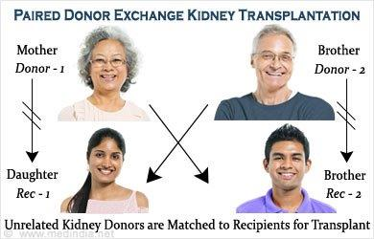
Types of living donors
Compatible (Blood type, HLA)
Related
Unrelated
Incompatible (Blood type, HLA)
Compatible but non-ideal (Age, size mismatch)

Slide 9
To learn about transplant outcomes for patients with C3G

Slide 10
Risks of Kidney Transplant - General
Complications during or immediately after the surgical procedure.
Bleeding
Infection
Pneumonia, wound infection, urinary tract infection
Urine drainage complication
Urine leak
Narrowing of the connection between ureter and bladder
Inability to empty bladder.
Risk associated with any general surgical procedure
Blood clots.
Heart attack or stroke.
Complications after the surgical procedure
Side effects of medications:diarrhea, headache, tremor
Infections
Rejection
Original kidney disease returns (e.g. C3G)

Slide 11
C3G (DDD) recurrence – I
NAPRTCS database (national pediatric transplant database)
Retrospective review (1985-2002)
75 patients with MPGN II (DDD): 44 were > 12 yrs old
5 yr graft survival 50% +/- 7.5 in MPGN II vs 74.3% +/- 0.6 for other
Among MPGNII patients living donor 5 yr survival (65.9% +/- 10.7) better than deceased donor (34.1% +/- 9.8%) survival
Recurrent disease caused graft failure in 14.7% of patients
No correlation with prior or post transplant C3 concentration
Braun et al., J Am Soc Nephrol. 2005 Jul;16(7):2225-33. Epub 2005 May 11.

Slide 12
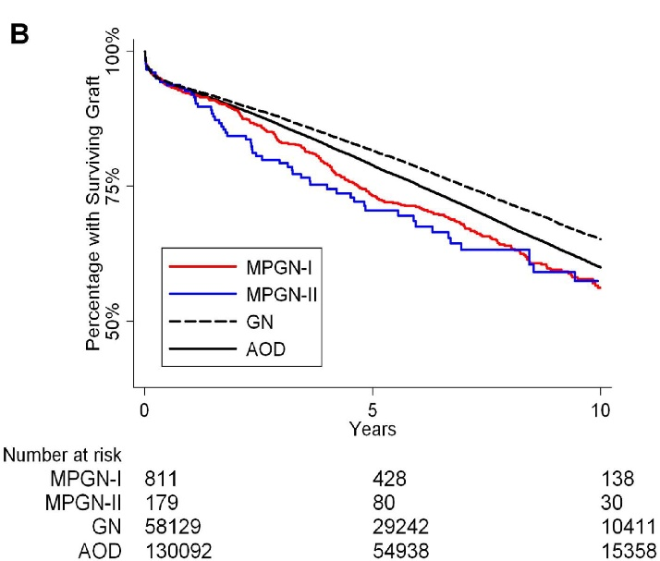
C3G (DDD)-recurrence II
UNOS database (US transplant database – all comers)
Retrospective review (1987-2007) - 189,211 patients
179 patients with MPGN II (DDD) – 0.1%: Median age 27 yr
Median kidney survival 11.1 yr (other GN 14.3 yr)
10 year kidney survival 57.5% in MPGN II (other GN 65.2 yr)
Recurrent disease caused graft failure in 29.5% of patients
Kidney survival in MPGNII compared to other
(death censored)
Angelo et al., American Journal of Kidney Diseases, 2011, 57: 291-299

Slide 13
C3G (C3GN) recurrence - III
21 patients at 1 institution with C3GN were transplanted
Original disease diagnosed at a median age of 21 years
14 of 21 (66.7%) recurred after transplant; 6 of 8 had low C3 prior
Median time to recurrence 28 months
3 of 14 had MGRS (Immunoglobulin or Ig excess from a process like myeloma)
Kidney failure in 50% of those who developed recurrent disease
Median time 77 months
Remaining 50% have functioning kidneys (median followup 73 months)
Zand et al., J Am Soc Nephrol. 2014, 25: 1110-1117

Slide 14
C3G – recurrence after transplant Summary
probably universal by biopsy – but may not always impact kidney function
clinically meaningful disease: 50% by 3-5 years
kidney failure in 50% by 7-15 years

Slide 15
Should patients with C3G be transplanted?
Any patient who has previously not been transplanted should be considered a candidate for a transplant.
Any patient who has been transplanted but not had early transplant failure from C3G recurrence should also be considered a candidate
Risk of recurrent disease may be influenced by
Sex, age, genetics, autoantibodies, complement activity
Not all recurrent disease leads to premature kidney loss
Consequence of early kidney loss
early kidney failure from C3G probably predicts recurrent early loss.
Exposure to donor kidney leads to development of antibodies to HLA antigens.
Sensitization (HLA antibodies) can make future transplants difficult.

Slide 16
When should patients with C3G be transplanted?
Ideally when the disease appears inactive
patient not requiring immunosuppressive therapy
Urine testing shows no red cells (blood) or casts
Signs of complement activation have resolved
Normal C3
undetectable C3 nephritic factor (if previously abnormal)
MORL assays: Normal CH50, Normal APFA, Normal hemolytic assay
Adults with monoclonal Ig (MGRS) should first be treated for the plasma cell disease

Slide 17
How should C3G patients be transplanted?
As with other transplants, a living donor is almost always preferable to a deceased donor transplant
Immunosuppressive regimen should include standard therapy – tacrolimus, MMF (mycophenolate, cellcept) +/- prednisone
No data to support pre-operative use of eculizumab
No data to support pre-operative plasma exchange
Transplant center should have a plan for monitoring for early transplant recurrence
Urine for blood (microscopic)
Urine protein or albumin

Slide 18
Treatment options for recurrence
No FDA approved treatment
Eculizumab (C5 convertase inhibition) -
Has been effective in some C3G cases
Most cases prior to transplantation
Some required months of therapy prior to response
Publication bias may be a problem (More reviews than cases)
C5aR inhibition – Phase 2- Avacopan
C3 inhibitor: Phase 2 - Pegcetacoplan
Factor B inhibition-Phase 3 – Ipatocopan (LPN023) - MAP
Pediatr Nephrol. 2014 Jun;29(6):1107-11. doi: 10.1007/s00467-013-2711-5. Epub 2014 Jan 10.
Am J Kidney Dis. 2015 Mar;65(3):484-9. doi: 10.1053/j.ajkd.2014.09.025. Epub 2014 Dec 17.
Clin Kidney J. 2015 Aug;8(4):445-8. doi: 10.1093/ckj/sfv044. Epub 2015 Jun 15.
Pediatr Nephrol. 2017 Jun;32(6):1023-1028. doi: 10.1007/s00467-017-3619-2. Epub 2017 Feb 24
Clin J Am Soc Nephrol. 2012 May;7(5):748-56. doi: 10.2215/CJN.12901211. Epub 2012 Mar 8.
Notes:
Fakhouri et al., Kidney Int. 2010 Aug;78(3):279-86. Epub 2010 May 5

Slide 19
Should plans for eculizumab be made preemptively?
Options
Prophylactic use of eculizumab ahead of and following transplant – insufficient data
Rescue therapy with eculizumab if recurrence occurs and cannot be controlled
Contingency planning - ideal
Insurance preapproval prior to transplant
Required vaccinations prior to transplant

Slide 20
To appreciate when chronic dialysis might be considered

Slide 21
Chronic dialysis
While waiting for a kidney transplant
Blood group, lack of living donors, HLA antibodies
If unable to find a willing transplant center
If patient wants to wait for better therapy for possible C3G recurrence
If early recurrent kidney transplant failure

Slide 22
Summary
Kidney transplantation is the preferred option for any patient with end stage kidney disease including from C3G
Get all recommended vaccines prior to transplant if able
Many vaccines including COVID19 are less effective after transplantation
Although the risk of recurrent disease is high, it may not occur early or lead to early loss of kidney function
Although no specific treatment for C3G after transplant is available, new treatments are in clinical trials
If transplant is not an option or if the wait is expected to be long, consider home hemodialysis rather than center-based dialysis (if able)

Slide 23
Questions

Slide 24
Additional material

Slide 25
Medical/Surgical Consultation
Transplant surgeons and nephrologists will
will:
Review your history
Perform a physical examination
Review your diagnostic tests
Goals:
Ensure you need a transplant
Ensure a transplant is the right decision for you
Ensure there are no medical or surgical reasons not to do a transplant
Ensure you have the information you need about the transplant process

Slide 26
Types of Kidney Donors
Deceased Donors
Patients are listed with UNOS (United Network for Organ Sharing).
Wait times vary based on a variety of factors including; time on dialysis, location, age, blood/tissue type.
Living Donors
Related (parent, child, sibling)
Unrelated (spouse, friend)
Benefits from a living kidney donor transplant:
Surgery can be electively scheduled.
Organ usually lasts longer than from a deceased donor.

Slide 27
Social Work Consultation
To assess your:
Ongoing caregiver support and transportation
Understanding of current medical condition and expectations of treatment
Medical compliance
Education and work history
Mental health and substance use history
To provide information about:
Post transplant requirements and potential needs
Caregiver roles, responsibilities, and expectations
Living wills and power of attorney for healthcare
It is essential to your transplant success that your primary caregiver attend all appointments.

Slide 28
Issues to consider
Getting ready:
Limit blood transfusions to the extent possible to reduce ‘HLA’ antibody production
Get evaluated for a transplant as soon as possible at a center that is willing to transplant C3G (eGFR < 20).
Transplant decision:
Decision complicated by risk of recurrence and lack of proven therapy.
However, 10-year kidney survival may be > 50%
If recurrence occurs, consider using eculizumab or entering a clinical trial

Slide 29
Once You Are Listed
Stay in touch with your nurse coordinator.
This nurse needs to know:
How to reach you.
You need to let us know of changes in your insurance coverage.
Any new test results (laboratory tests, heart tests, scans, etc…).
If you become sick and need antibiotics or hospital care.

Slide 30
Responsibilities After Transplant
You must learn about your immunosuppression
medications and their side effects.
You must take them as prescribed, daily, for the lifetime of your transplant.
You must not stop these drugs unless directed to by a member of the transplant team.
If your insurance affects your ability to get these drugs, let us know right away. WE CAN HELP!
If your transplant is not performed at a Medicare approved facility, this may affect your ability to have immunosuppression paid for under Medicare Part B.

Slide 31
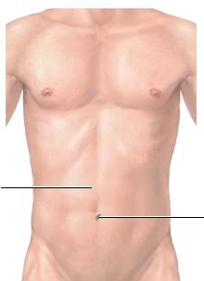
Kidney Transplant
Immunosuppressive medications for life

