Slide 1
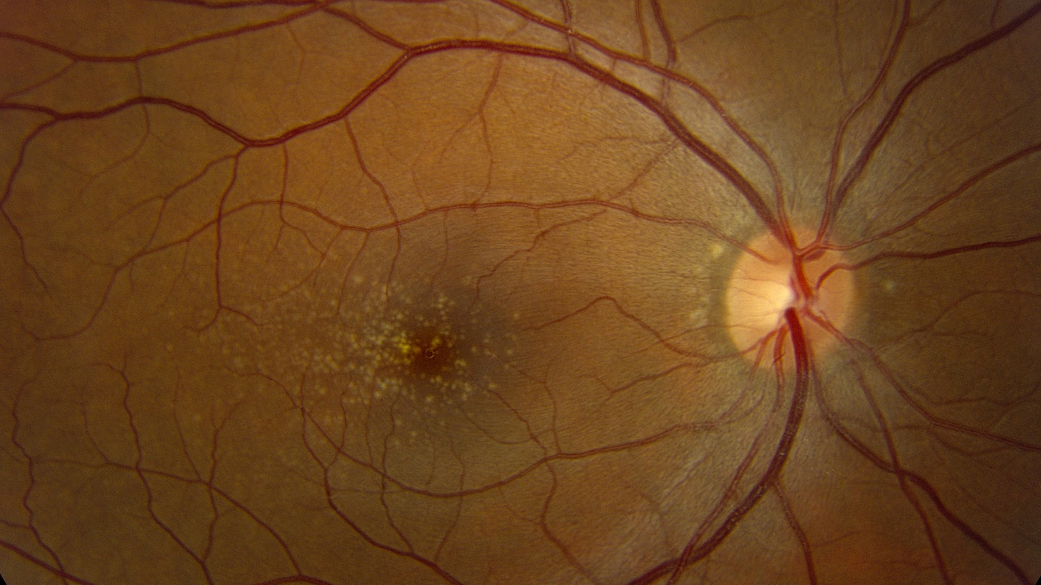
C3G and the Eye
Ian C. Han, MD
Associate Professor
Institute for Vision Research
Department of Ophthalmology and Visual Sciences
C3 Glomerulopathy 17th Family Conference | October 15, 2022

Slide 2
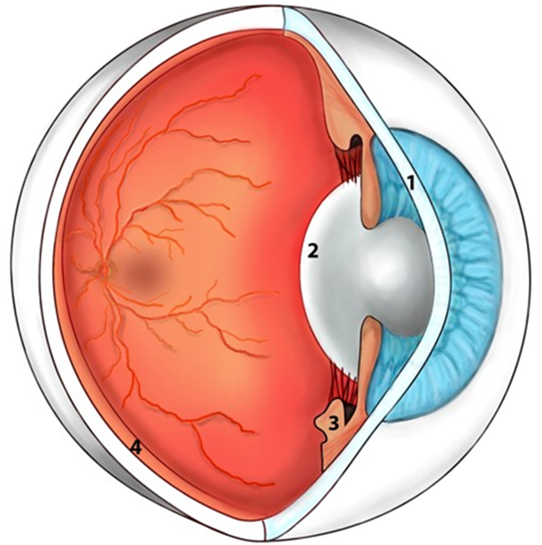
Eye Anatomy
C3 Glomerulopathy 17th Family Conference | C3G and the Eye

Slide 3
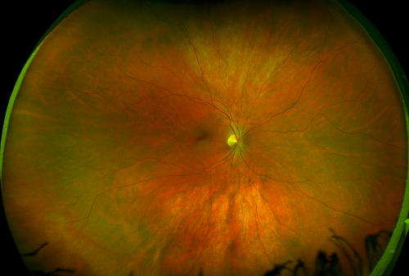
Normal Retina
C3 Glomerulopathy 17th Family Conference | C3G and the Eye

Slide 4
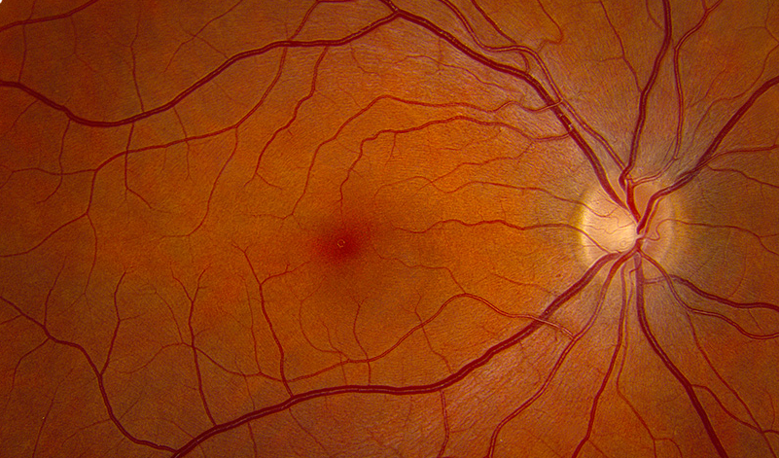
Normal Macula
C3 Glomerulopathy 17th Family Conference | C3G and the Eye

Slide 5
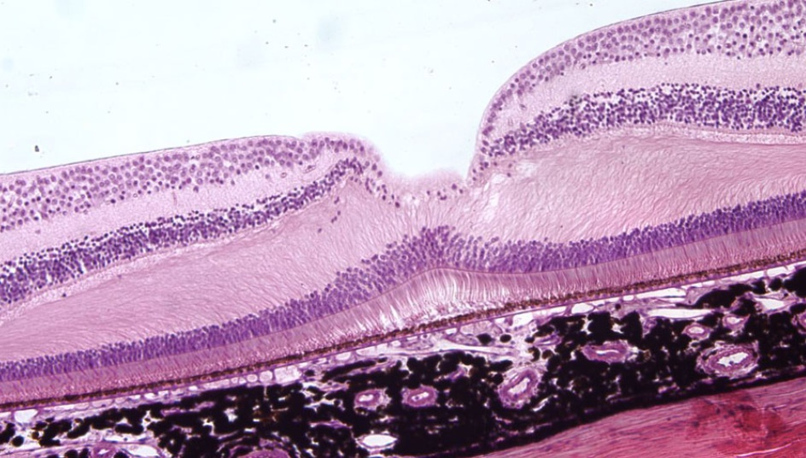
Normal Retina
C3 Glomerulopathy 17th Family Conference | C3G and the Eye

Slide 6
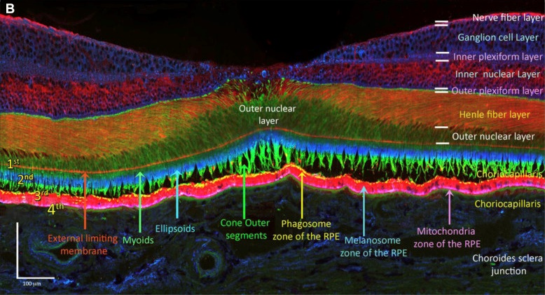
Normal Retina
Cuenca et al. Ophthalmology. 2018 Mar;125(3):407-422
C3 Glomerulopathy 17th Family Conference | C3G and the Eye

Slide 7
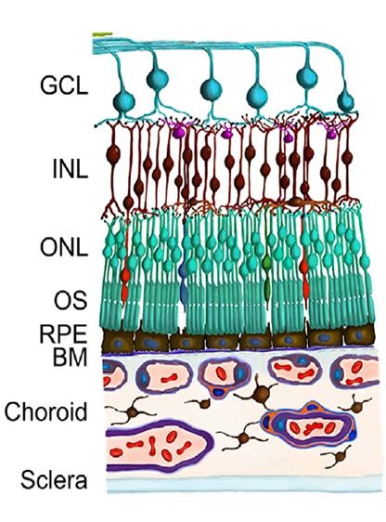
Normal Retina
C3 Glomerulopathy 17th Family Conference | C3G and the Eye

Slide 8
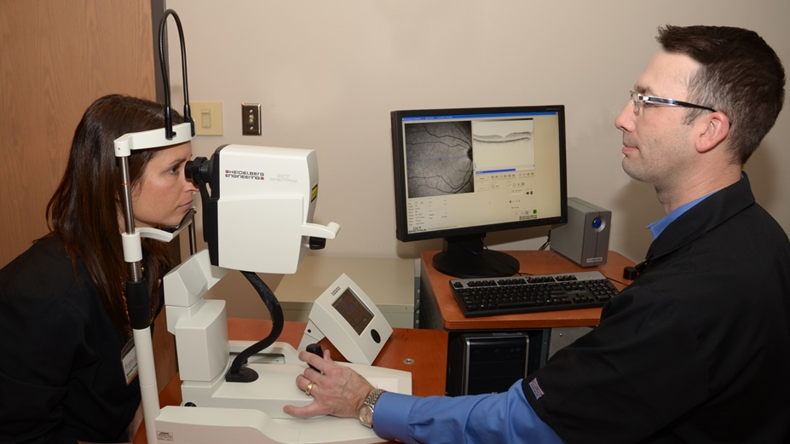
Optical Coherence Tomography (OCT)
C3 Glomerulopathy 17th Family Conference | C3G and the Eye

Slide 9
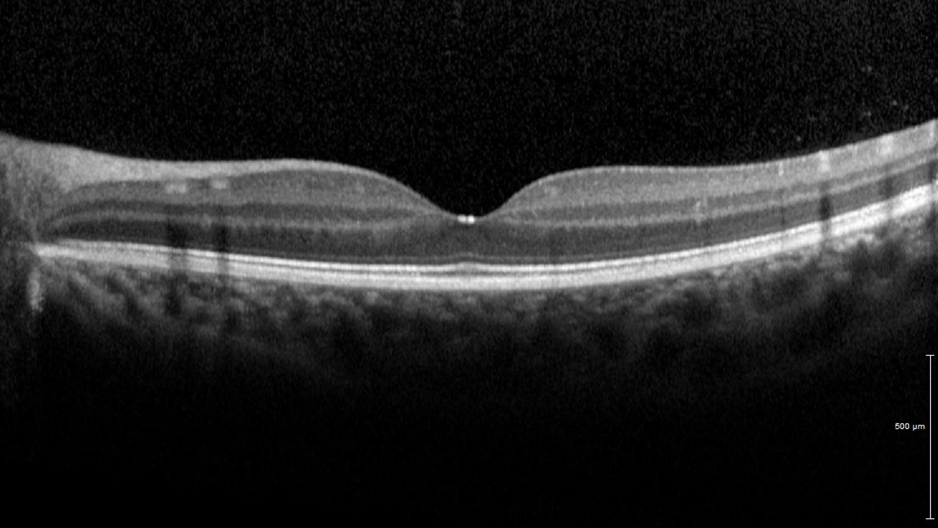
OCT | Normal Retina
C3 Glomerulopathy 17th Family Conference | C3G and the Eye

Slide 10
Normal Macula
C3 Glomerulopathy 17th Family Conference | C3G and the Eye

Slide 11
Macular Drusen in C3G
C3 Glomerulopathy 17th Family Conference | C3G and the Eye

Slide 12
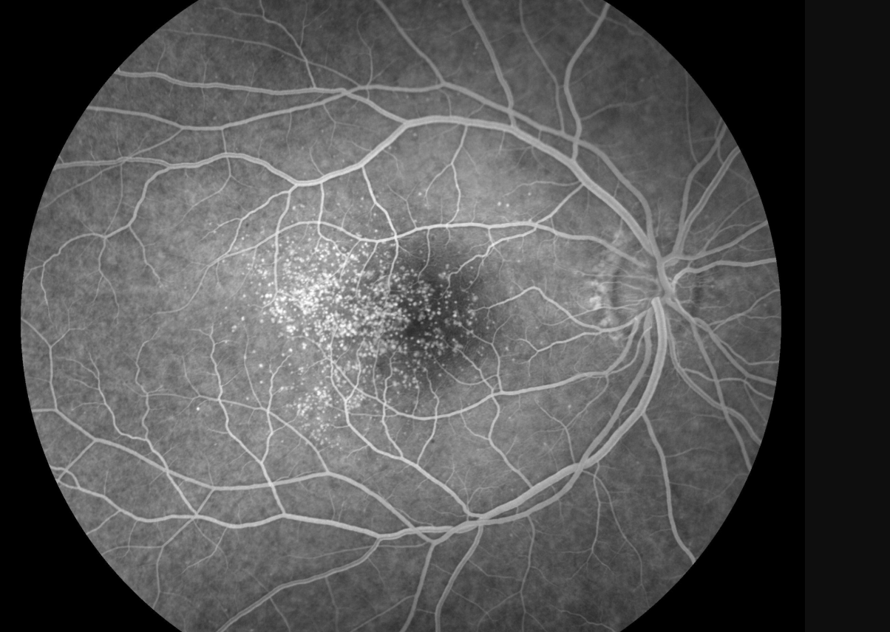
Macular Drusen in C3G
C3 Glomerulopathy 17th Family Conference | C3G and the Eye

Slide 13
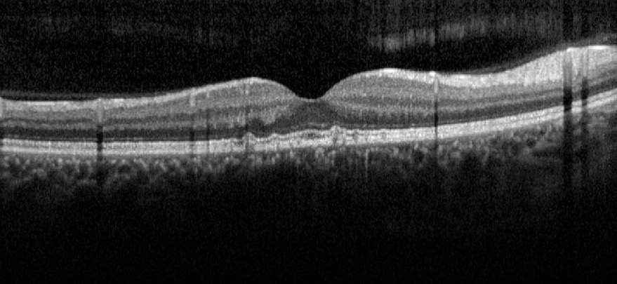
OCT | Macular Drusen in C3G
C3 Glomerulopathy 17th Family Conference | C3G and the Eye

Slide 14
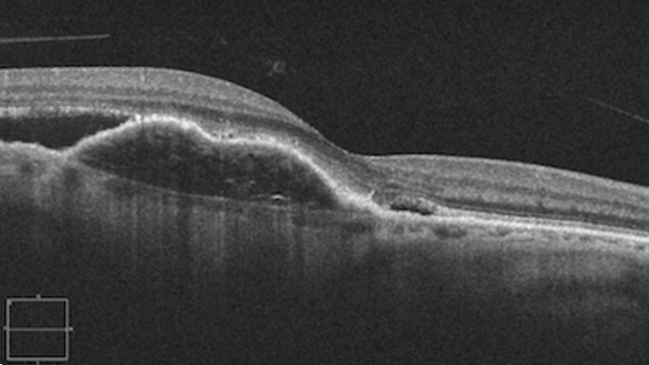
OCT | Choroidal Neovascularization
C3 Glomerulopathy 17th Family Conference | C3G and the Eye

Slide 15
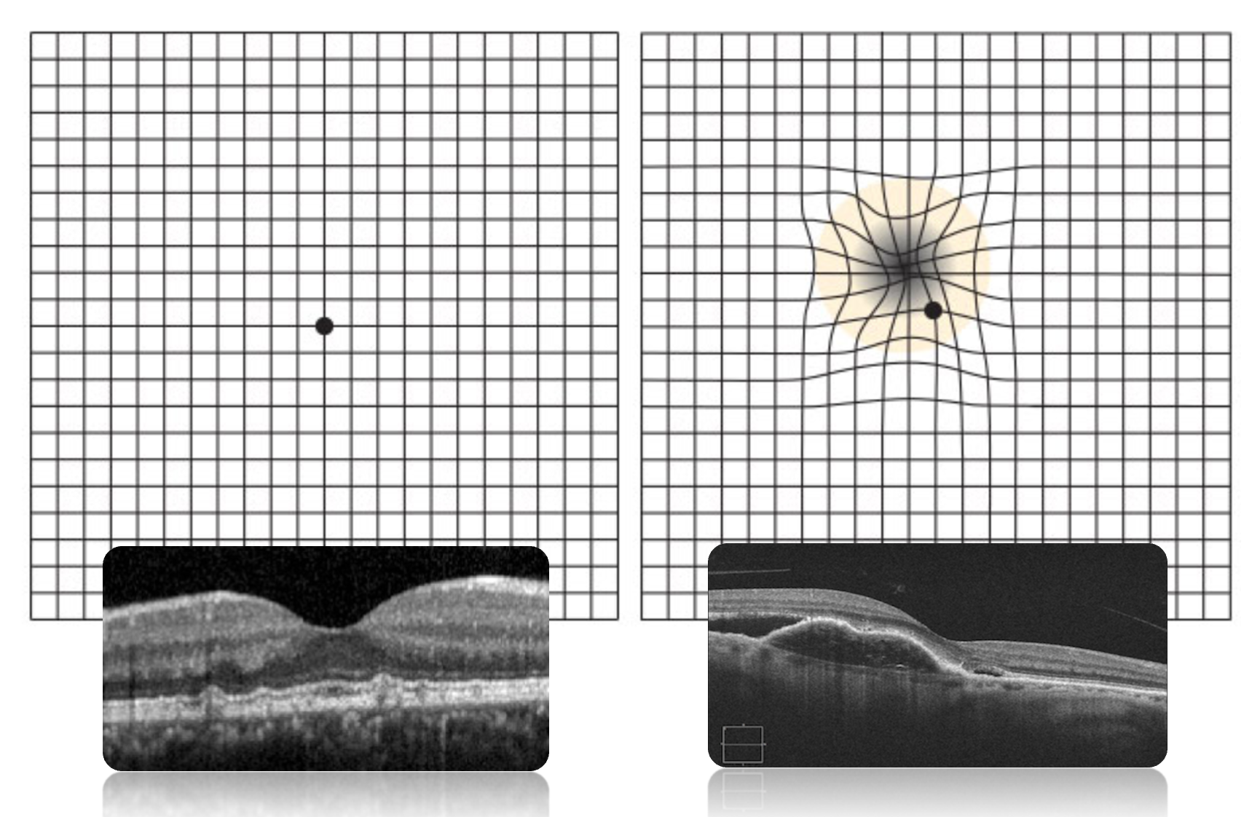
C3 Glomerulopathy 17th Family Conference | C3G and the Eye

Slide 16
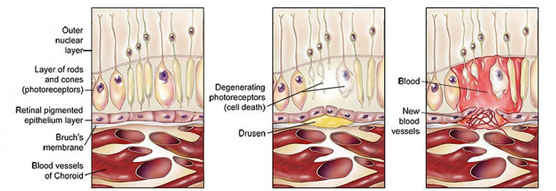
Drusen and Choroidal Neovascularization
Choroidal Neovascularization
Normal
Drusen
C3 Glomerulopathy 17th Family Conference | C3G and the Eye
Adapted from: https://www.brightfocus.org/macular/infographic/what-macular

Slide 17
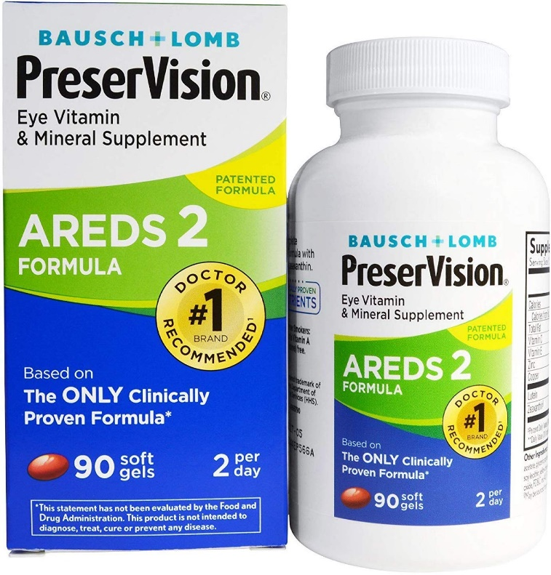
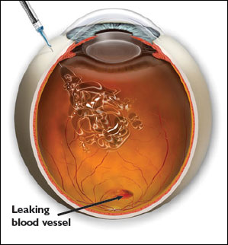
Prevention | Treatment
C3 Glomerulopathy 17^{h} Family Conference | C3G and the Eye

Slide 18
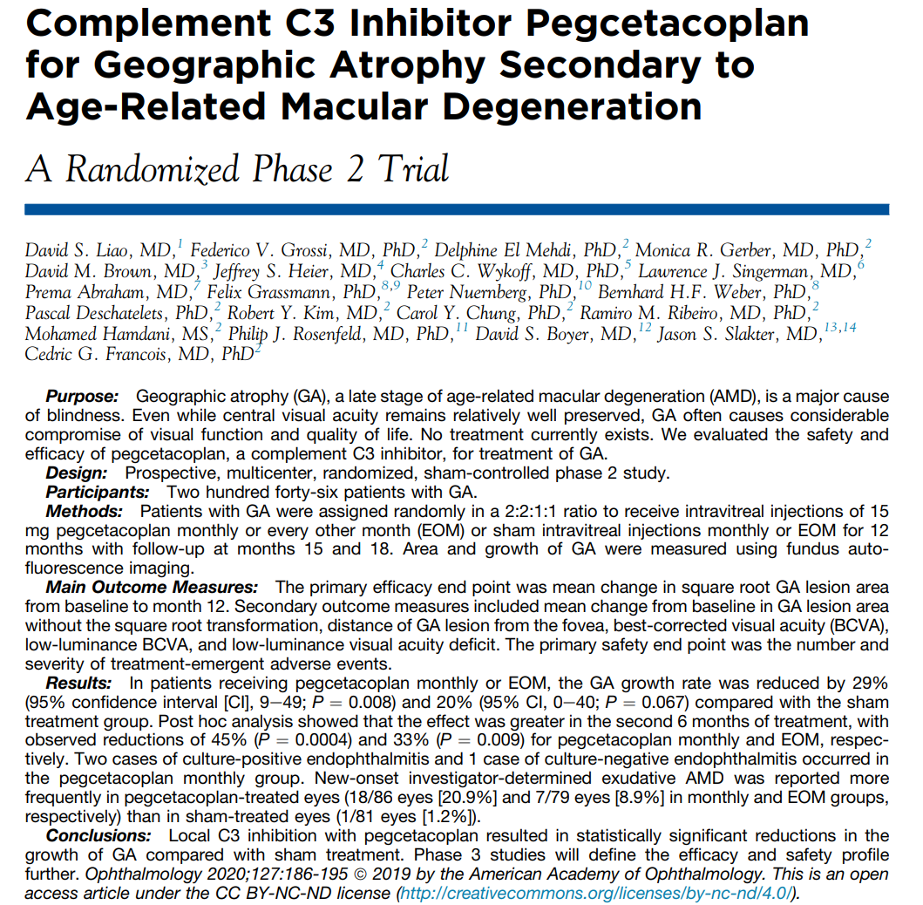
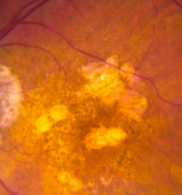
C3 Glomerulopathy 17^{h} Family Conference | C3G and the Eye
https://www.aaojournal.org/article/S0161-6420(18)33132-4/fulltext

Slide 19
C3 Glomerulopathy 17^{h} Family Conference | C3G and the Eye
https://eyerounds.org/cases/259-GA-Drusen.htm

Slide 20
